Slide 1

1. Study of Measuring, Testing, Power Supply Instruments and Breadboard Course: ECE1008 – Electronic Hardware Troubleshooting LAB
-Dr Richards Joe Stanislaus
Assistant Professor - SENSE
Email: 51749@vitstudent.ac.in

Slide 2
Mode of Communication
Experiment Queries/doubts: Post them in your group channel
Personal Queries/doubts: Post them directly in Teams personal chat
You may also write email to : 51749@vitstudent.ac.in with subject Fall2021-22: ECE1008: SubjectOfYourEmail
LAB experiment outputs: Post them to your group channel (One output for each task. Please split the work among group members)
Prepare a report for each experiment and upload them in LMS link (will be shared for individual experiments once CTS creates LMS link).
LAB files will be posted in Course page of ECE1008 and in General channel of the Team.

Slide 3
Grades
LAB Experiment reports: 60 marks
LAB FAT exam: 50 marks : will be scaled to 40 marks

Slide 4
1.0 Course introduction
No Prerequisite
Course Objectives[CoB]:
To understand the process of identification and testing of various electronic components and instruments.
To understand the working, construction and design of the electronic instruments.
To study the effect of open circuit, short circuit and loading effects.
To introduce the troubleshooting methods of electronic circuits.
To understand the process of PCB layout and implementation of various circuits on it.

Slide 5
1.0 Course introduction
Course Outcomes[Co]
[1] Perform testing and identification of various electronic components and instruments.
[2] Perform trouble shooting of simple electronic circuits based on diodes and transistors.
[3] Design a voltage divider, charging circuit, clipper and clamper circuits for a given specifications.
[4] Demonstrate the loading effect and impedance matching.
[5] Design a bridge circuit with capacitors, resistors, dc & ac input and analyze the effect of open circuit and short circuit.
[6] Demonstrate the usage of power supplies, measuring and indicating instruments.
Perform soldering, basic operations of hardware trouble shooting on a PCB. Construct and implement basic application oriented circuits on PCB.

Slide 6
1.0 Course introduction
Student Learning Outcomes (SLO):
[2] Having a clear understanding of the subject related concepts and of contemporary issues
[5] Having design thinking capability
[14] Having an ability to design and conduct experiments, as well as to analyze and interpret data problems

Slide 7
Tentative list of experiments
1. Study of Measuring, Testing, Power Supply Instruments and Breadboard.
Study of simple RLC circuits for making connection and measuring current & voltages
2. Testing and Trouble shooting of Diodes and Transistors.
VI characteristics of PN /ZENER Diode, NPN Transistor in CE, CB & CC configurations diode
3. Trouble shooting of Clamper and Clipper Circuits.
Various Positive/Negative clipper in series and shunt connection with bias and all
4. Trouble shooting and testing of power supply.
Bridge rectifier with RC filter
5. Use of C.R.O to find Mid-band Voltage gain and Frequency Response of Amplifiers.
Design of CE amplifier and measuring its frequency response
6. Trouble shooting and Testing of NMOS Inverter, NMOS NOR and NAND Logic with Pull-Up resistor
NMOS & PMOS circuits for various logic gates (AND, OR & NOT)

Slide 8
Tentative list of experiments
7. Trouble shooting and Testing of NMOS and Diode connected with Pull-Up resistor for A specific logic.
NMOS & PMOS with resistor for various logic gates (AND, OR & NOT)
8. Easy EDA online tool for simple circuit
9. Trouble shooting and testing of power Inverter.
Lt spice simulation with diode/transformer
10. Trouble shooting and testing of multi-meter.
11. Trouble shooting and testing of equalizer circuits.
12. Trouble shooting and testing of emergency light.

Slide 9
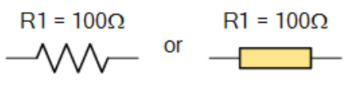
1.1 Basics of Resistors
These are Passive Devices (require no additional power source)
Within an electrical or electronic circuit: Purpose is to “resist”, regulate or to set the flow of electrons (current) through them.
Electrical energy is lost in the form of heat in resistor.
They can be connected together in series and parallel combinations to form resistor networks.
This results in resistors as voltage droppers, voltage dividers or current limiters within a circuit.
Standard resistor symbol:

Slide 10
1.1 Basics of Resistors: Types
Carbon Composition Resistor – Made of carbon dust or graphite paste, low wattage values
Film or Cermet Resistor – Made from conductive metal oxide paste, very low wattage values
Wire-wound Resistor – Metallic bodies for heatsink mounting, very high wattage ratings
Semiconductor Resistor – High frequency/precision surface mount thin film technology

Slide 11
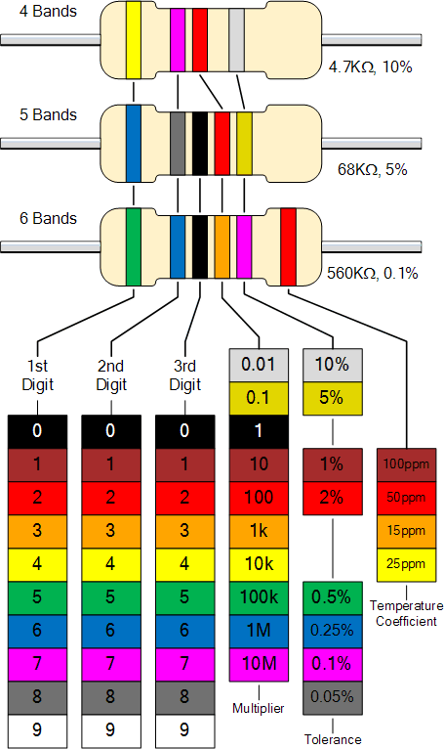
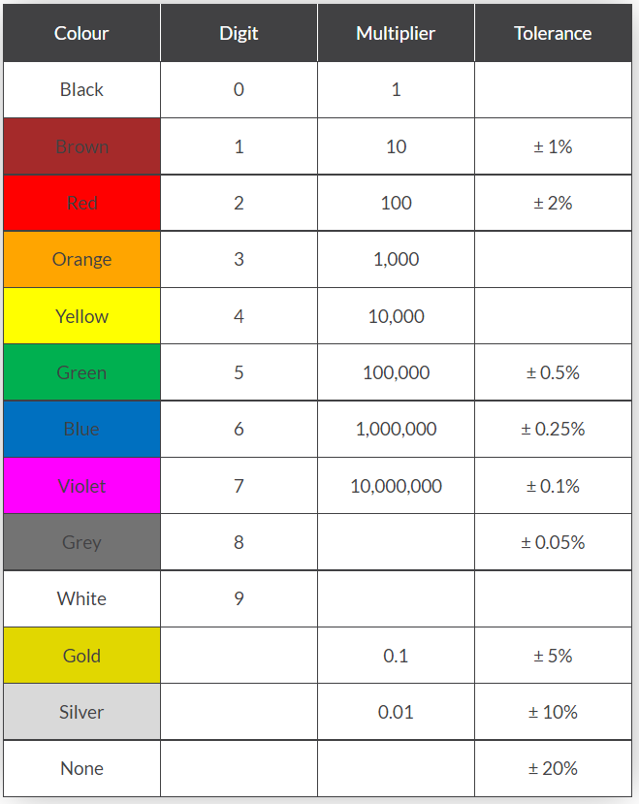
1.1 Basics of Resistors
Colour Coding: 4 bands 5 bands 6 bands

Slide 12
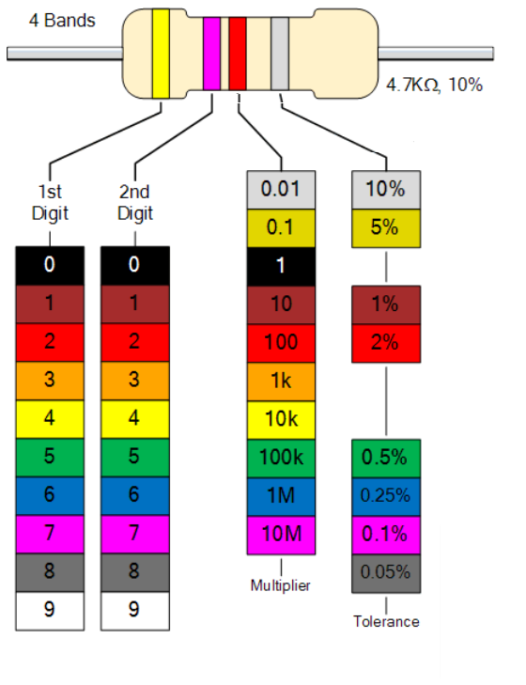
1.1 Basics of Resistors
4 band basics 1st: 1st Digit 2nd : 2nd Digit 3rd : Multiplier 4th: Tolerance

Slide 13
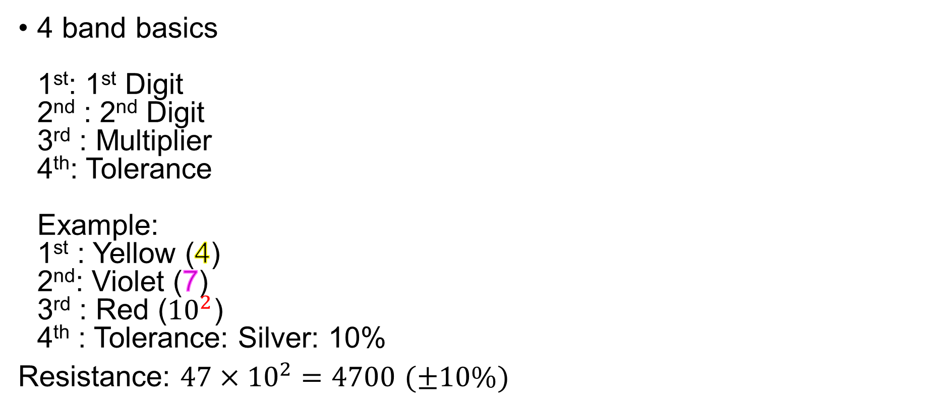
1.1 Basics of Resistors
4 band basics 1st: 1st Digit 2nd : 2nd Digit 3rd : Multiplier 4th: Tolerance Example: 1st : Yellow (4) 2nd: Violet (7) 3rd : Red (${10}^{2}$) 4th : Tolerance: Silver: 10%
Resistance: $47×{10}^{2}=4700$ $(±10\%)$

Slide 14
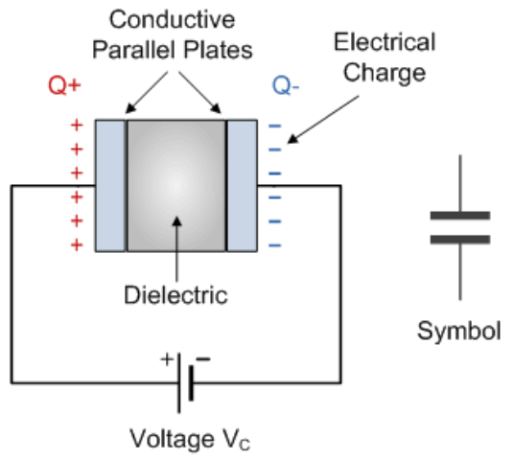
1.2 Capacitor
component which has the ability or “capacity” to store energy in the form of an electrical charge producing a potential difference (Static Voltage) across its plates, much like a small rechargeable battery.
Basic form: consists of two or more parallel conductive (metal) plates which are not connected or touching each other, but are electrically separated either by air or by some form of a good insulating material such as waxed paper, mica, ceramic, plastic or some form of a liquid gel as used in electrolytic capacitors.
The insulating layer between a capacitors plates is commonly called the Dielectric.

Slide 15
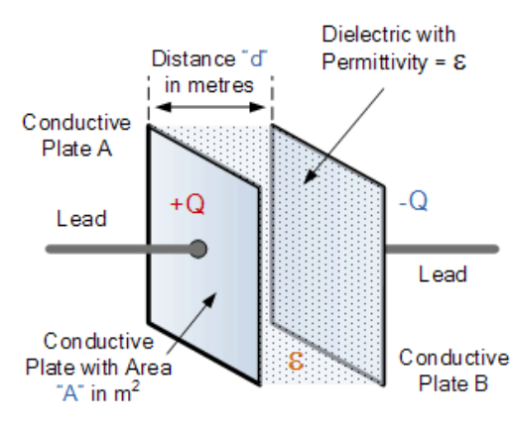
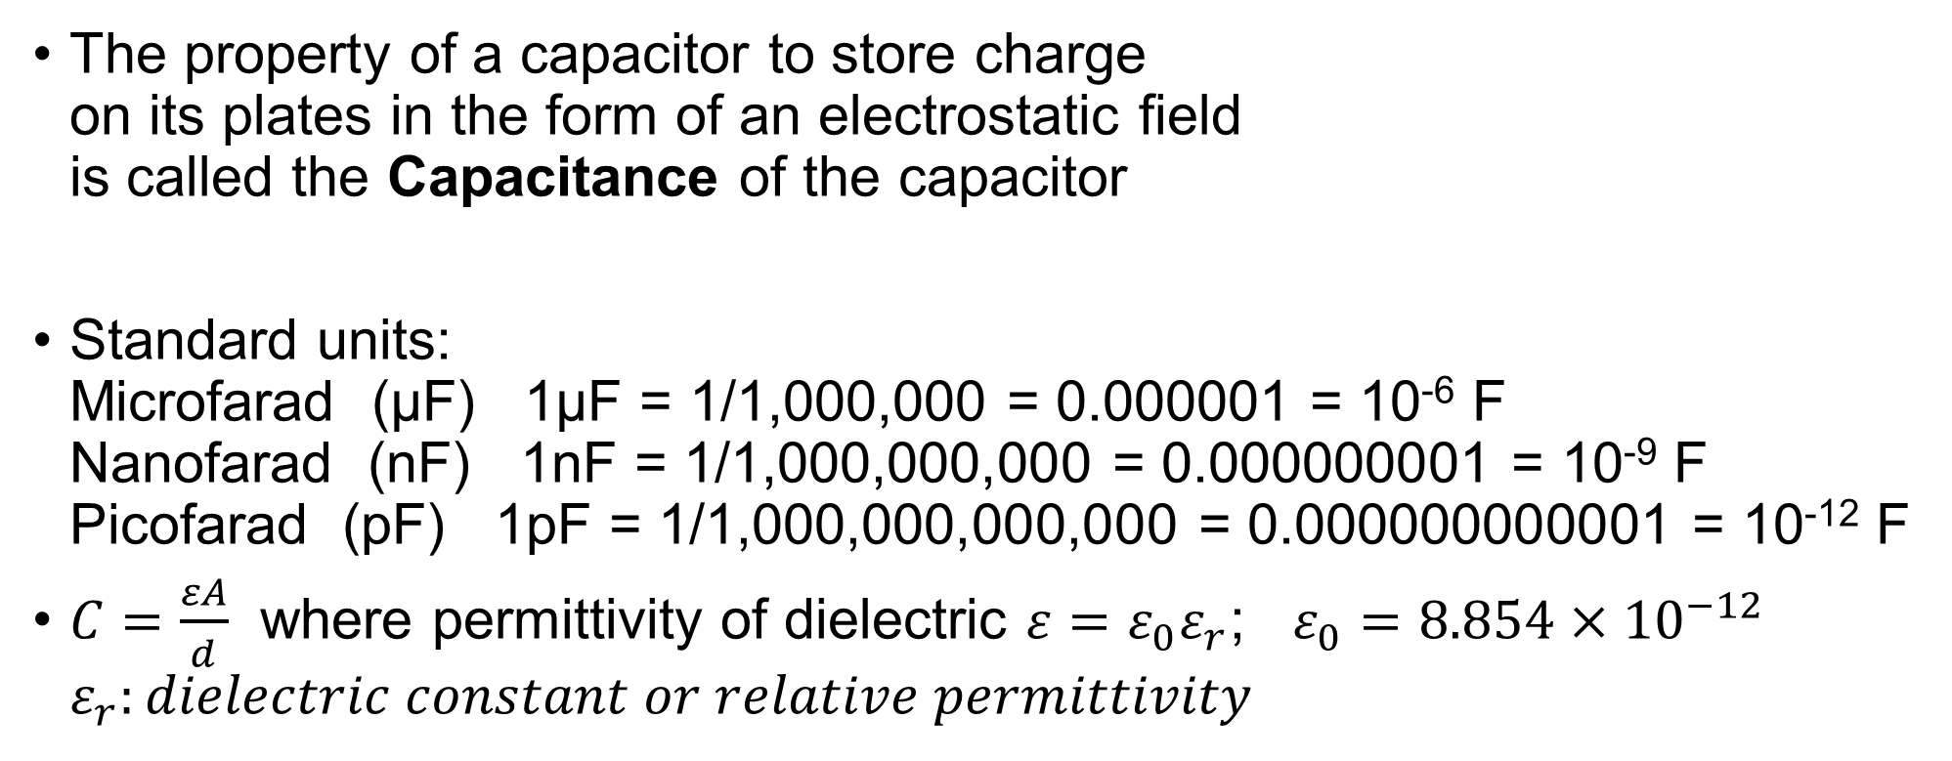
1.2 Capacitor
The property of a capacitor to store charge on its plates in the form of an electrostatic field is called the Capacitance of the capacitor
Standard units: Microfarad (μF) 1μF = 1/1,000,000 = 0.000001 = 10⁻⁶ F Nanofarad (nF) 1nF = 1/1,000,000,000 = 0.000000001 = 10⁻⁹ F Picofarad (pF) 1pF = 1/1,000,000,000,000 = 0.000000000001 = 10⁻¹² F
$C=\frac{εA}{d}$ where permittivity of dielectric $ε=ε_{0}ε_{r}$; $ε_{0}=8.854×{10}^{−12}$ $ε_{r}:dielectric constant or relative permittivity$

Slide 16
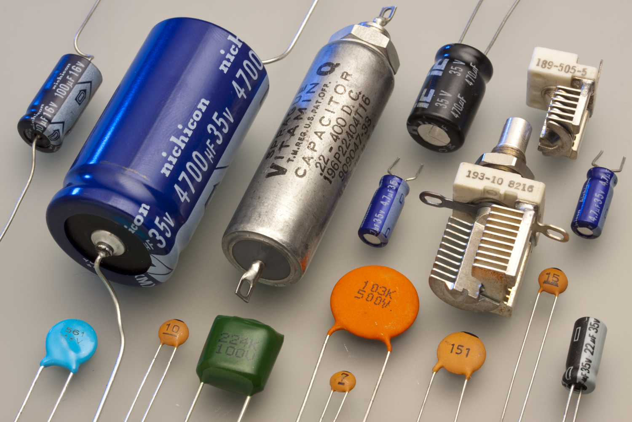
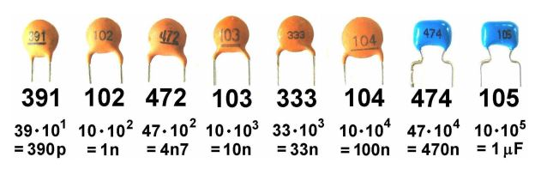
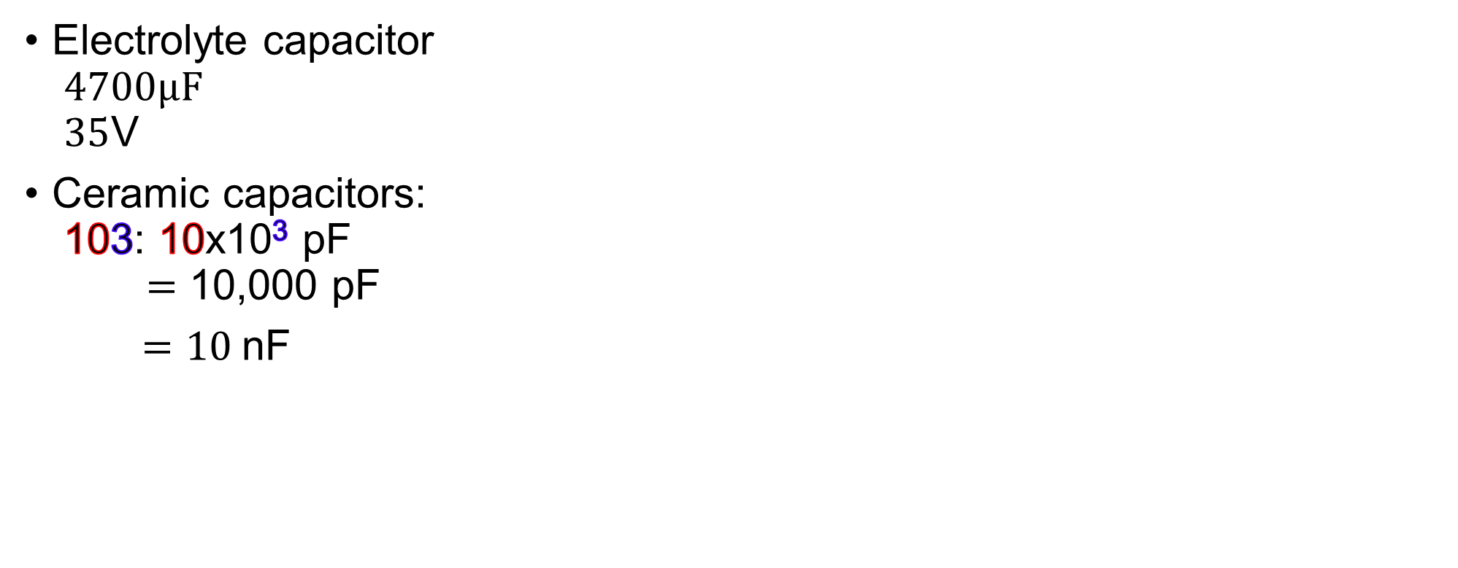
1.2 Capacitor
Electrolyte capacitor $4700μF$ $35$V
Ceramic capacitors: 103: 10x10³ pF $=$ 10,000 pF
$=10$nF

Slide 17
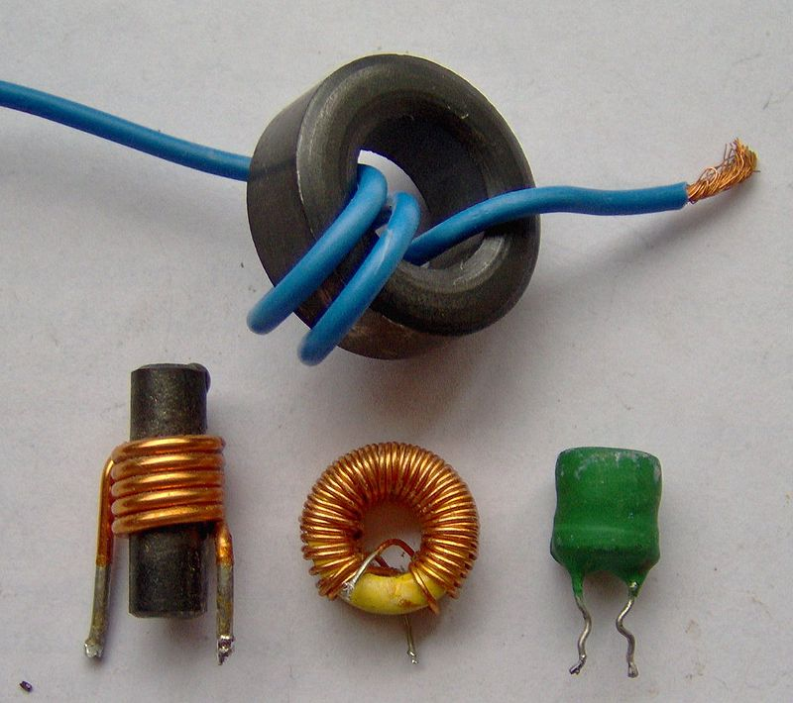
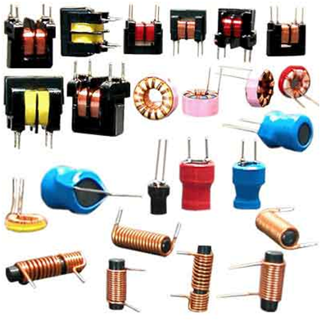
1.3 Inductor
An inductor, also called a coil, choke, or reactor, is a passive two-terminal electrical component that stores energy in a magnetic field when electric current flows through it.
An inductor typically consists of an insulated wire wound into a coil.

Slide 18
1.3 Inductor
An inductor is characterized by its inductance, Inductance: ratio of the voltage to the rate of change of current.
Unit of inductance is the henry (H) n
In the measurement of magnetic circuits, it is equivalent to weber/ampere.
Inductors have values that typically range from 1 µH (10⁻⁶ H) to 20 H.
Many inductors have a magnetic core made of iron or ferrite inside the coil, which serves to increase the magnetic field and thus the inductance.
Inductance formulae: https://en.wikipedia.org/wiki/Inductor

Slide 19
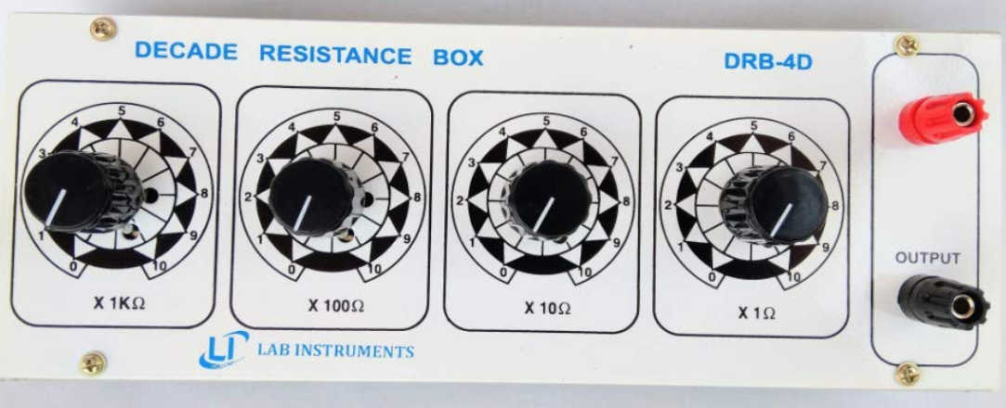
1.4 Decade resistance box

Slide 20
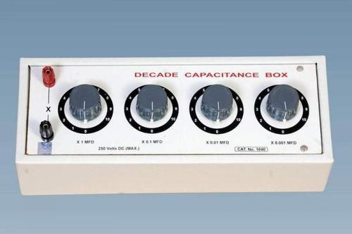
1.5 Decade Capacitance box (uF)

Slide 21
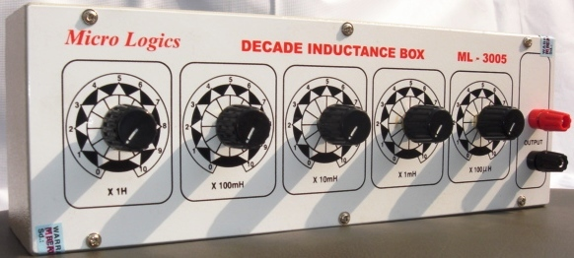
1.6 Decade inductance box

Slide 22
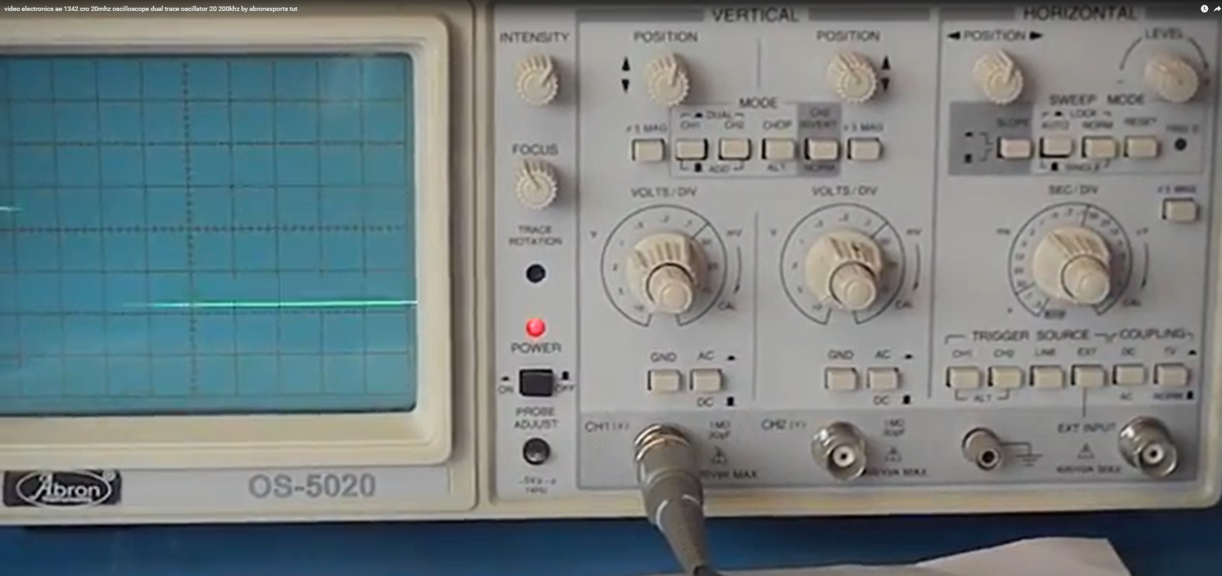
1.7 Oscilloscope

Slide 23
1.7 Oscilloscope: time(x axis) vs Voltage(y axis)

Slide 24
1.7 Oscilloscope: time(x axis) vs Voltage(y axis)

Slide 25
1.7 Oscilloscope: time(x axis) vs Voltage(y axis)

Slide 26
1.7 Oscilloscope: time(x axis) vs Voltage(y axis)

Slide 27
1.7 Oscilloscope: Trigger source

Slide 28
1.7 Oscilloscope: Trigger source

Slide 29
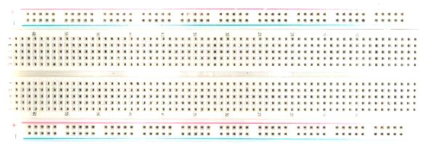
1.9 Breadboard

Slide 30
1.9 Breadboard
Supply and Ground
Vertical lines in blue represent internal connection Ground and Supply may be connected in the top horizontally connected sections.

Slide 31
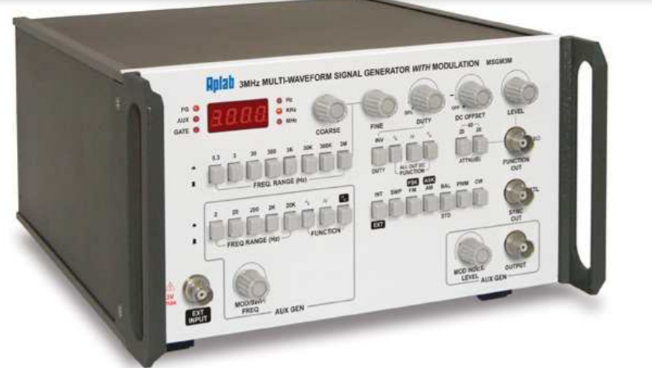
1.10 Signal generator (Upto 30MHz)

Slide 32
1.10 Signal generator (Upto 30MHz)
Adjust amplitude
Frequency selection 0.3Hz to 30MHz
Output

Slide 33
1.10 Signal generator (Upto 30MHz)
Adjust amplitude
Frequency selection 0.3Hz to 30MHz
Output
Select type of waveform, Duty cycle (On period in one wave form)
Duty cycle

Slide 34
1.10 Signal generator (Upto 30MHz)
Adjust amplitude
Frequency selection 0.3Hz to 30MHz
Output
Select type of waveform, Duty cycle (On period in one wave form)
Attenuation
Duty cycle

Slide 35
1.10 Signal generator (Upto 30MHz)
Provide DC offset
Adjust amplitude
Frequency selection 0.3Hz to 30MHz
Output
Select type of waveform, Duty cycle (On period in one wave form)
Attenuation
Duty cycle

Slide 36
1.10 Signal generator (Upto 30MHz)
With main output, We have aux generator (upto 20KHz) Type of wave form: Sine, square, Ramp
Aux output

Slide 37
1.10 Signal generator (Upto 30MHz)
With main output, and aux generator We can perform modulation (FM, AM, etc)
Aux output

Slide 38
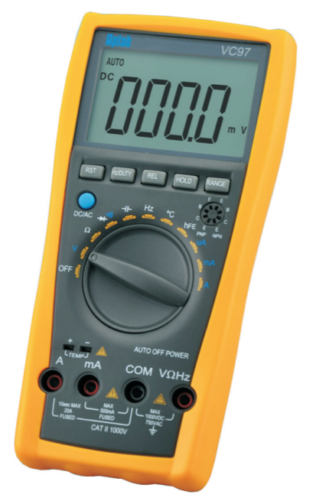
1.11 Multimeter
OFF, Voltage, Resistance, Diode(sound), Capacitance, Frequency, Temp, Gain(hFE), Current (uA, mA, A)

Slide 39
1.11 Multimeter
OFF, Voltage, Resistance, Diode(sound), Capacitance, Frequency, Temp, Gain(hFE), Current (uA, mA, A)
One cable in Common
For Voltage/Impedance/Frequency measurement, test probe:

Slide 40
1.11 Multimeter
OFF, Voltage, Resistance, Diode(sound), Capacitance, Frequency, Temp, Gain(hFE), Current (uA, mA, A)
One cable in Common
For Voltage/Impedance/Frequency measurement, test probe:
For current - upto 20A For current – upto 500mA

Slide 41
1.11 Multimeter
OFF, Voltage, Resistance, Diode(sound), Capacitance, Frequency, Temp, Gain(hFE), Current (uA, mA, A)
One cable in Common
For Voltage/Impedance/Frequency measurement, test probe:
For current - upto 20A For current – upto 500mA
Transistor Check NPN and PNP

Slide 42
1.11 Multimeter
OFF, Voltage, Resistance, Diode(sound), Capacitance, Frequency, Temp, Gain(hFE), Current (uA, mA, A)
One cable in Common
For Voltage/Impedance/Frequency measurement, test probe:
For current - upto 20A For current – upto 500mA
Transistor Check NPN and PNP
Adjust range, hold value, Check duty cycle, Reset

Slide 43
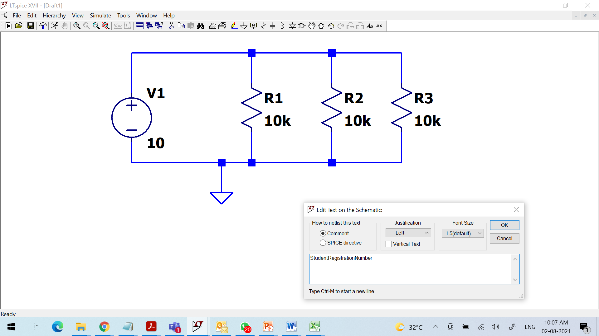
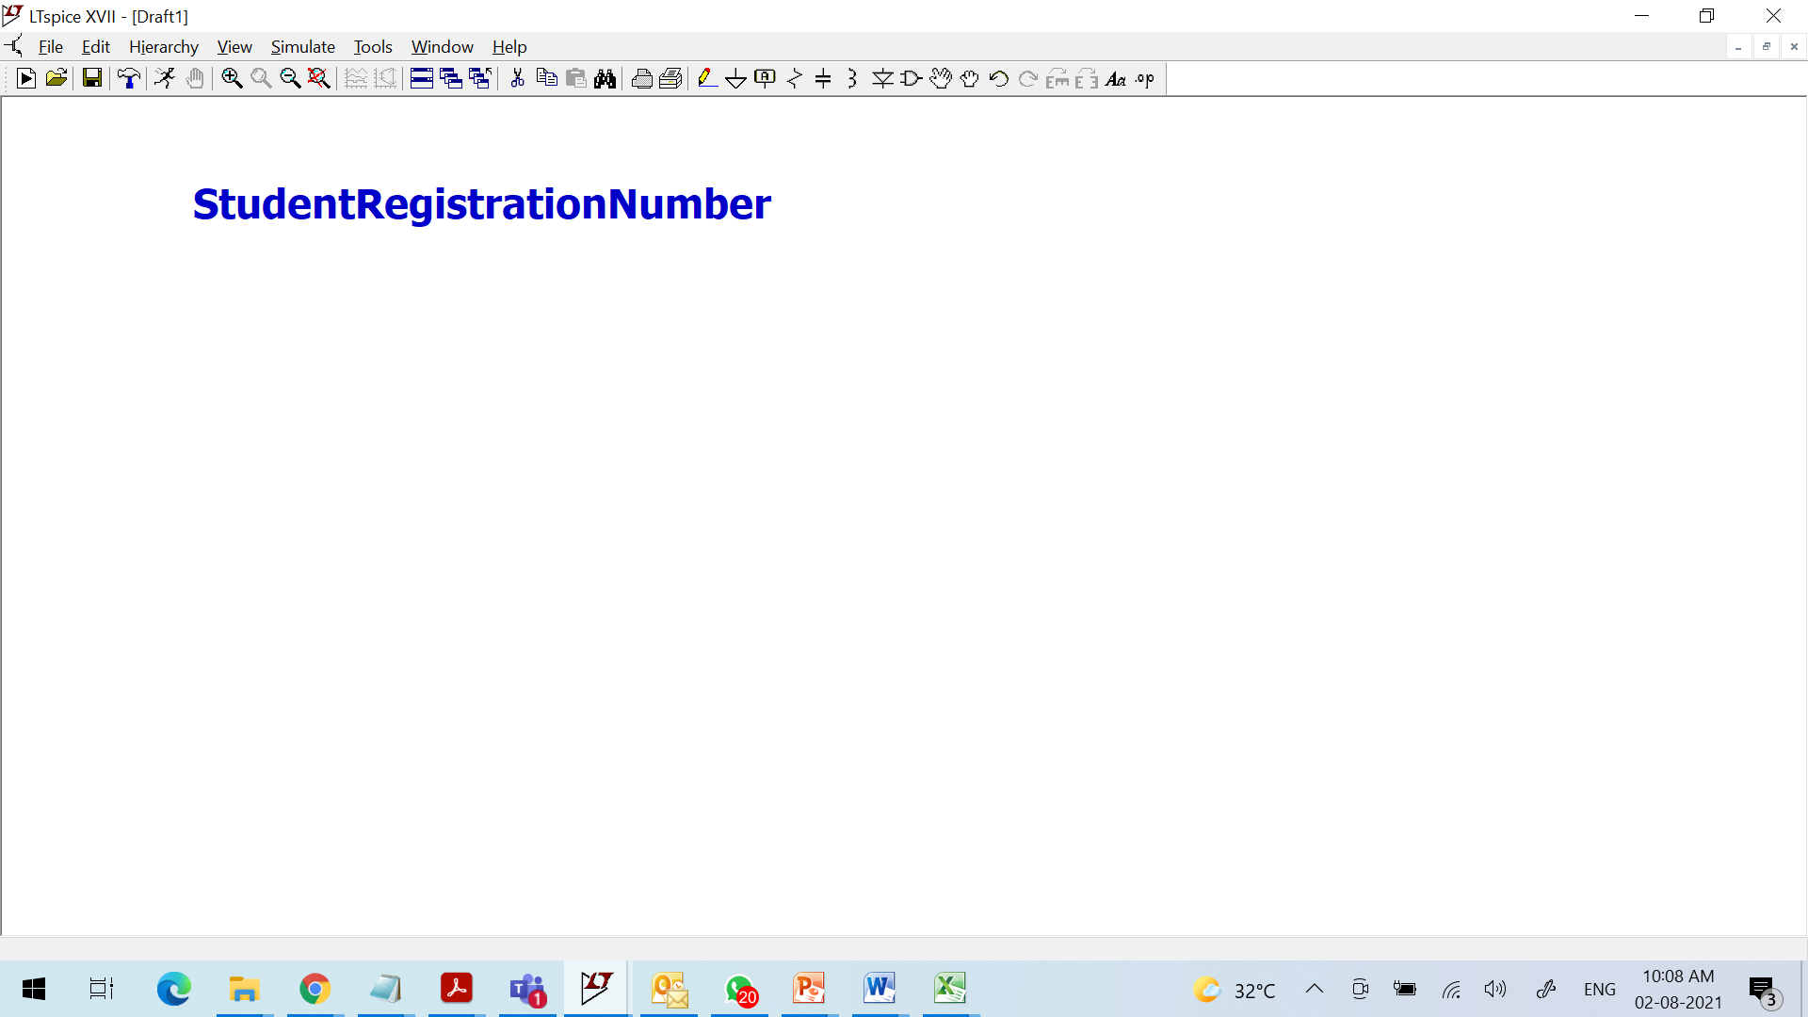
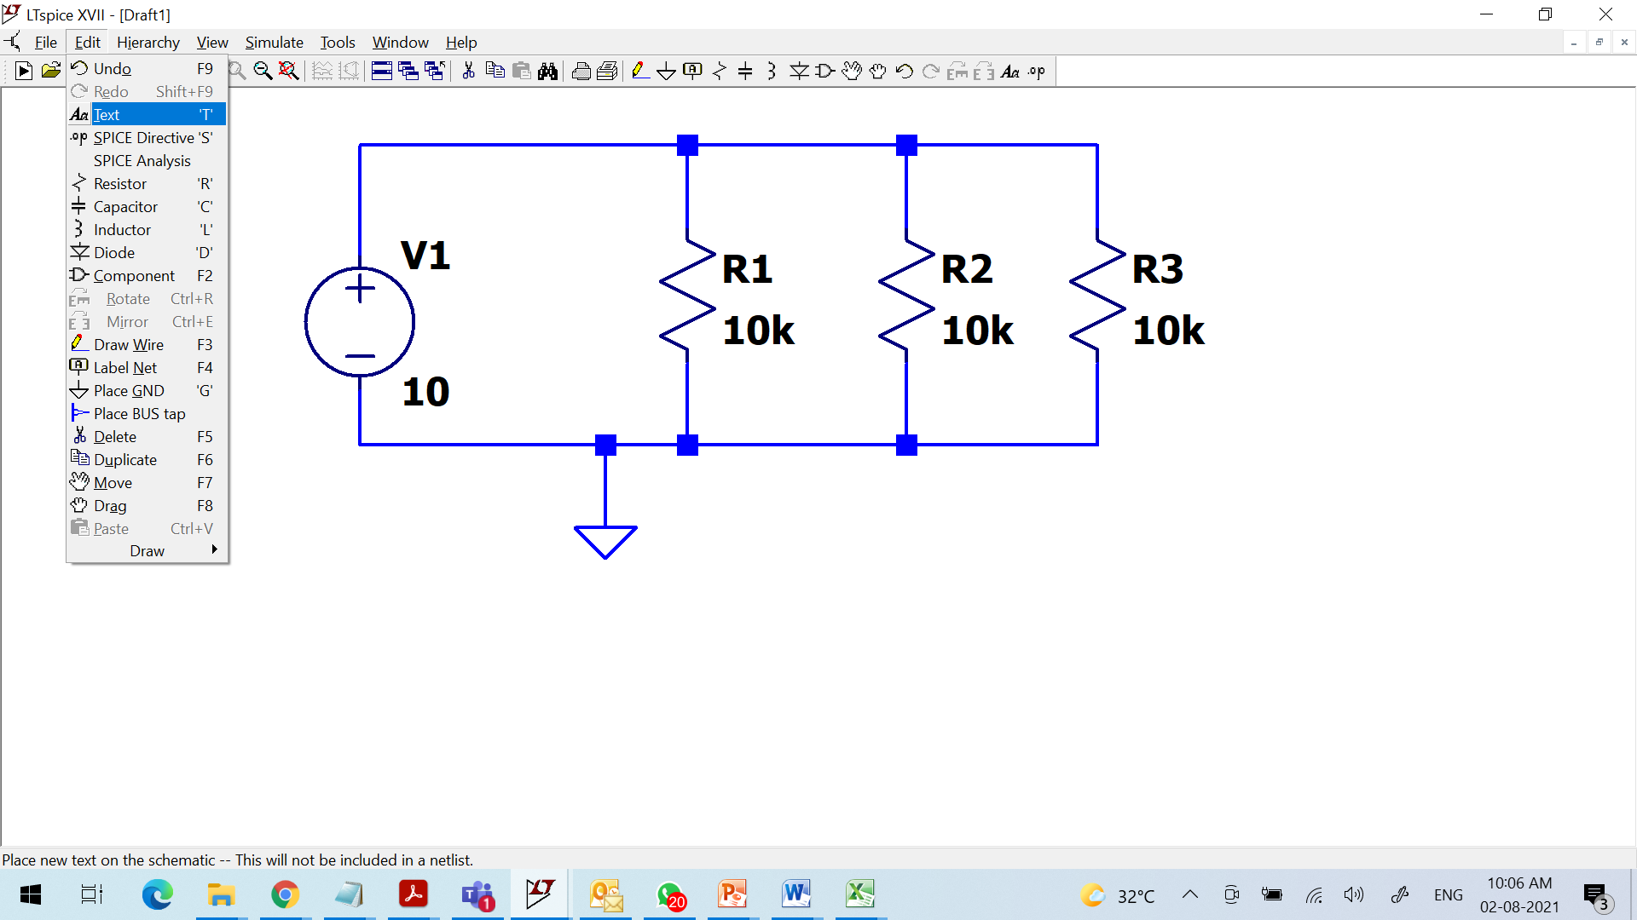
1.12 Introduction to LT Spice
Or

Slide 44
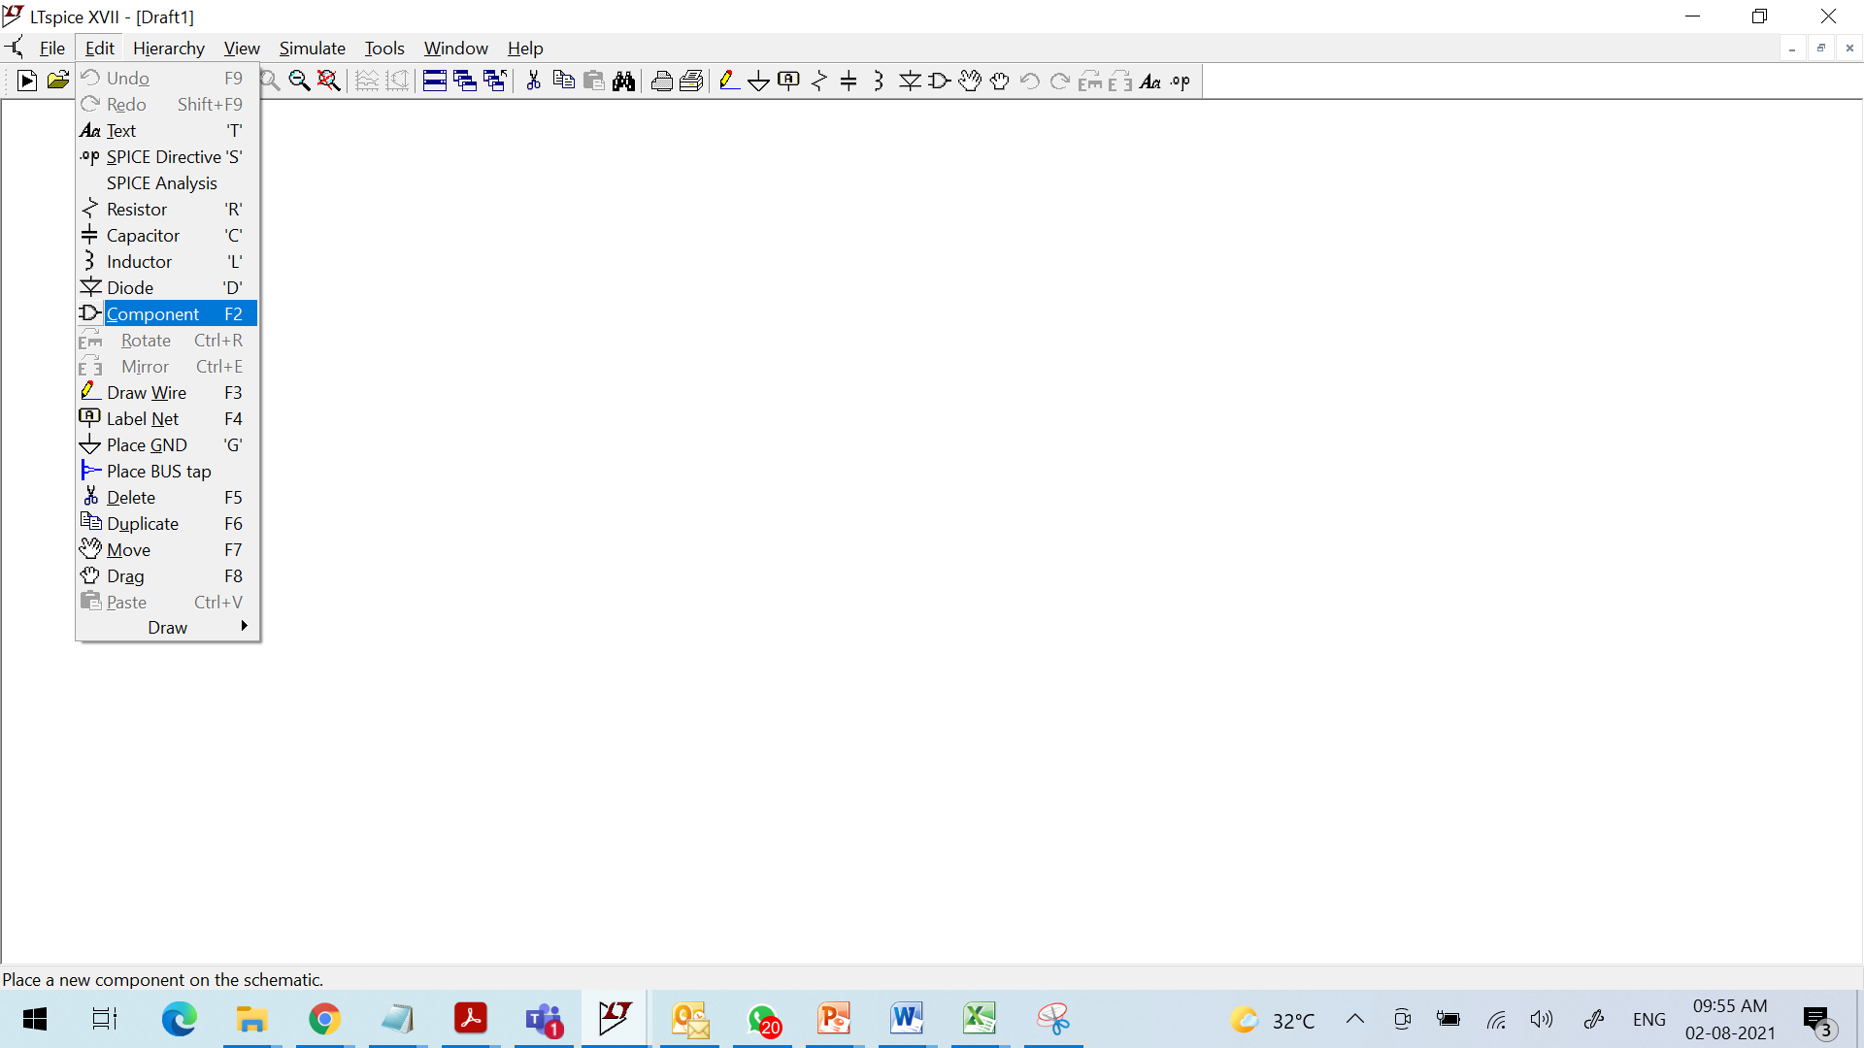
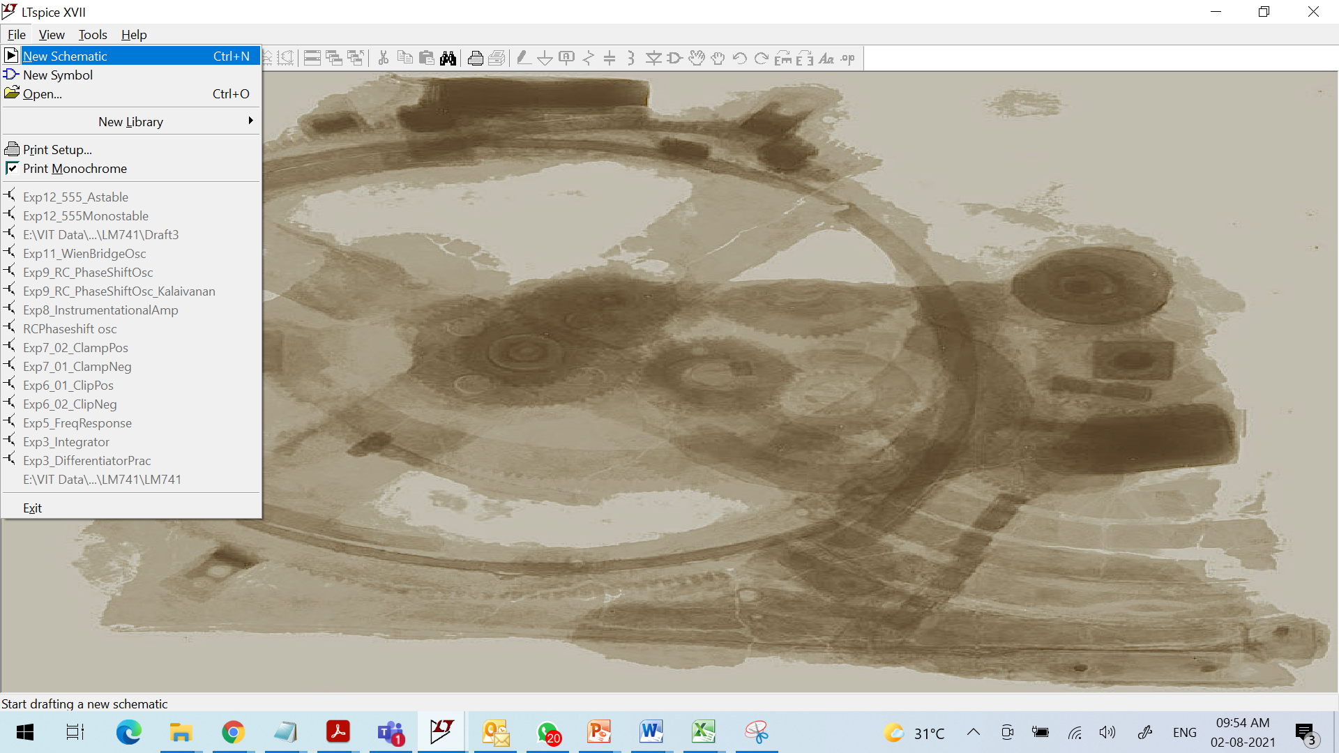

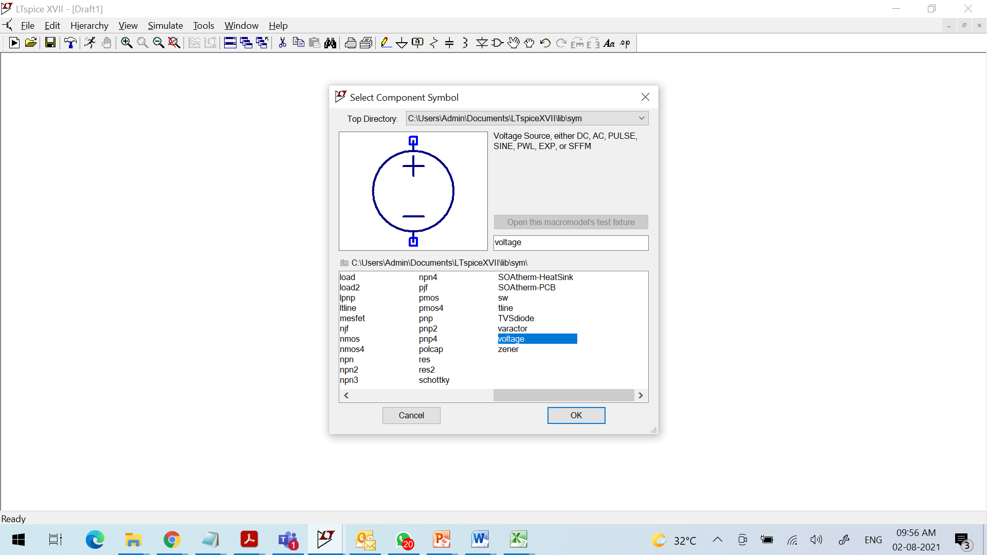
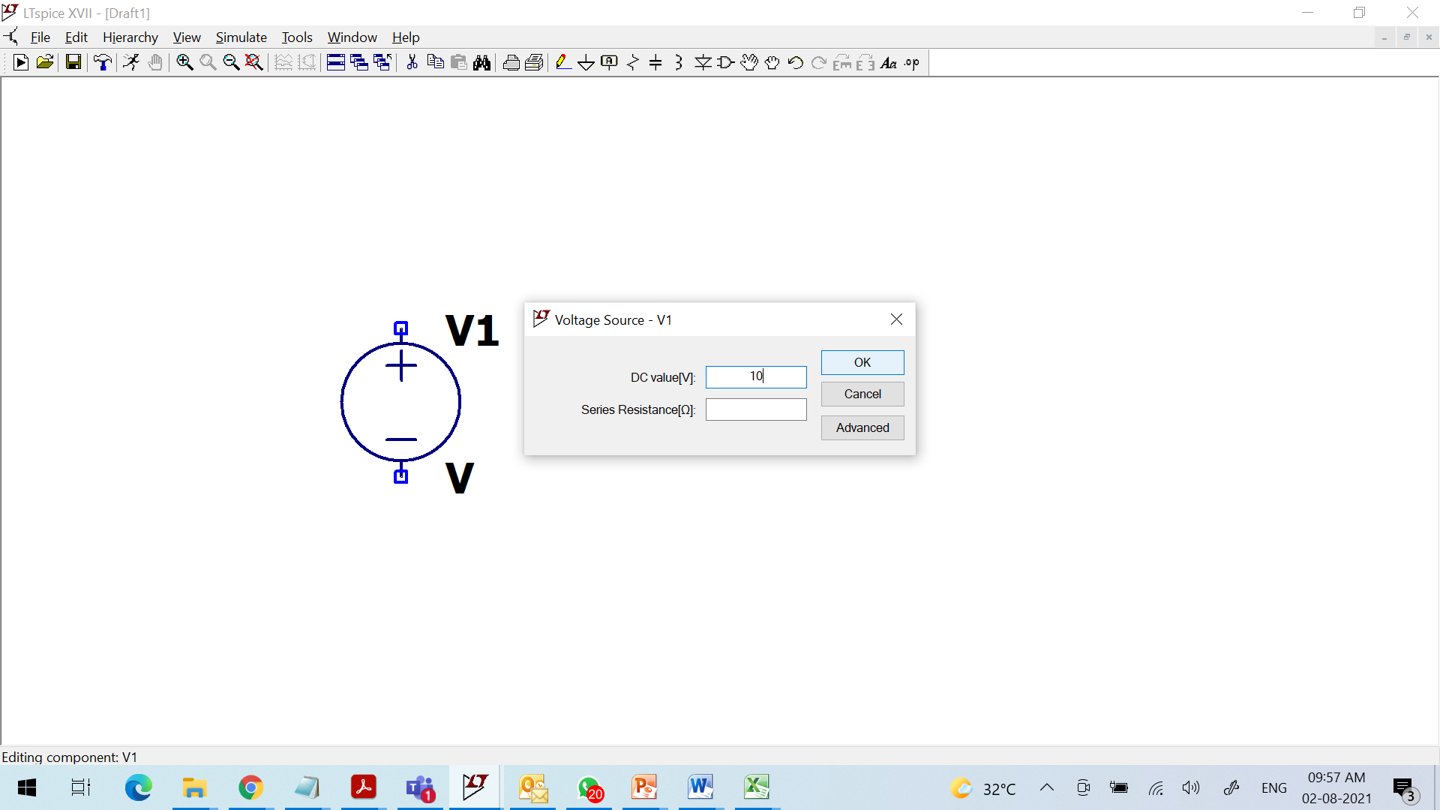
1.12 Introduction to LT Spice
Or

Slide 45
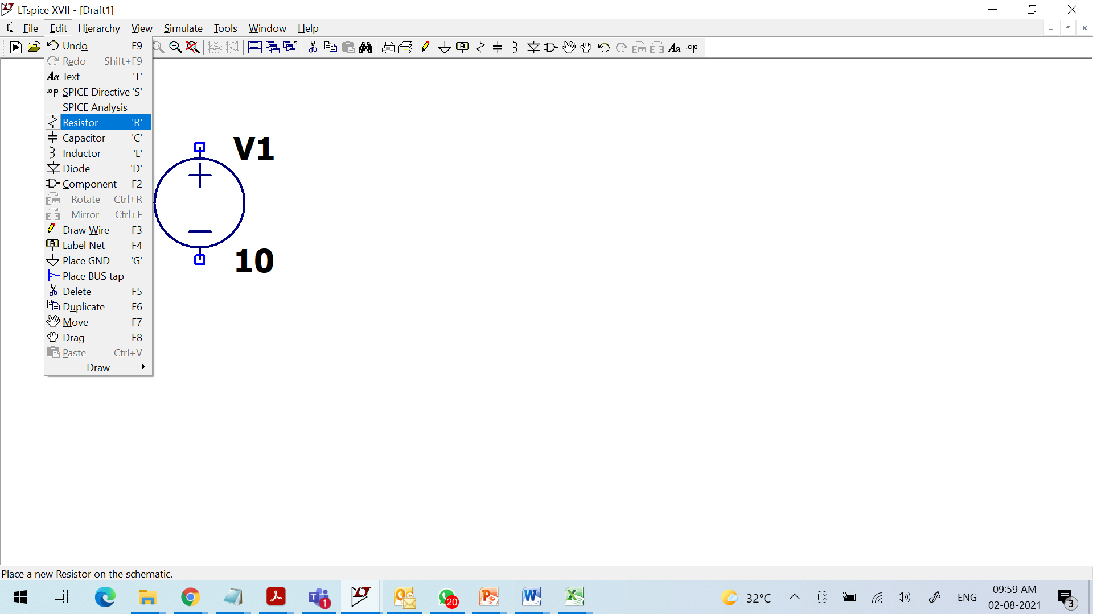
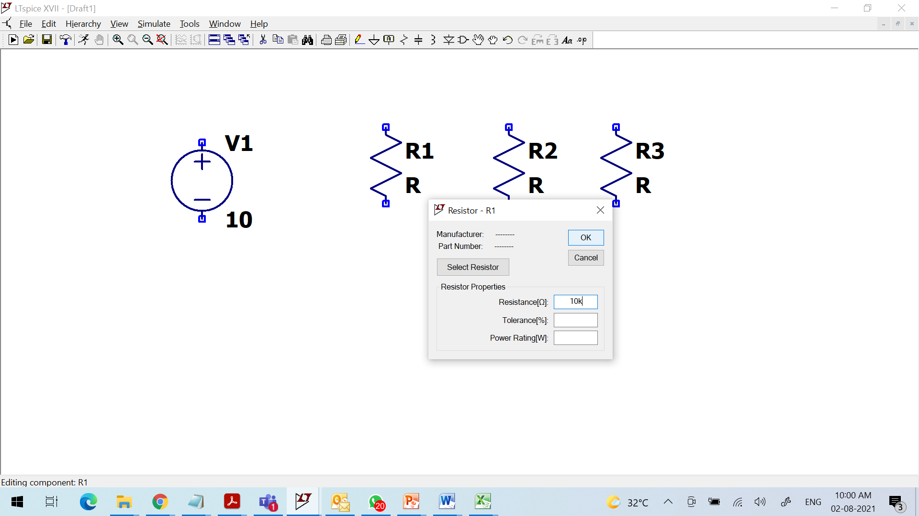
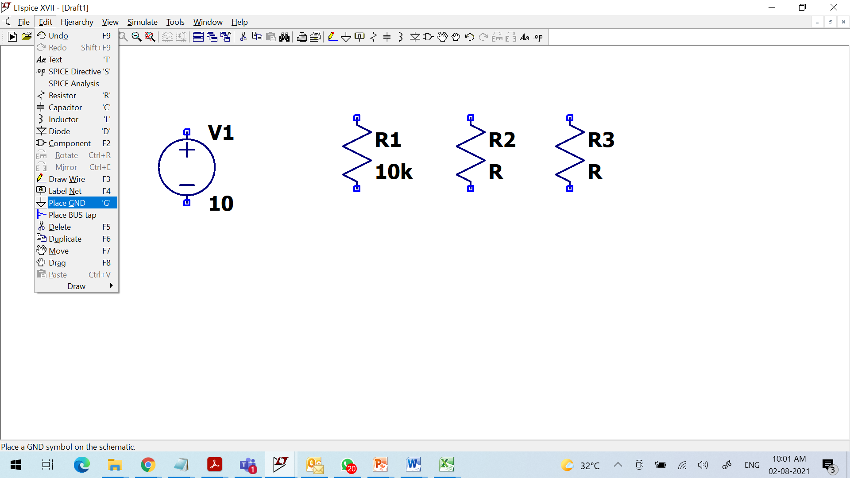
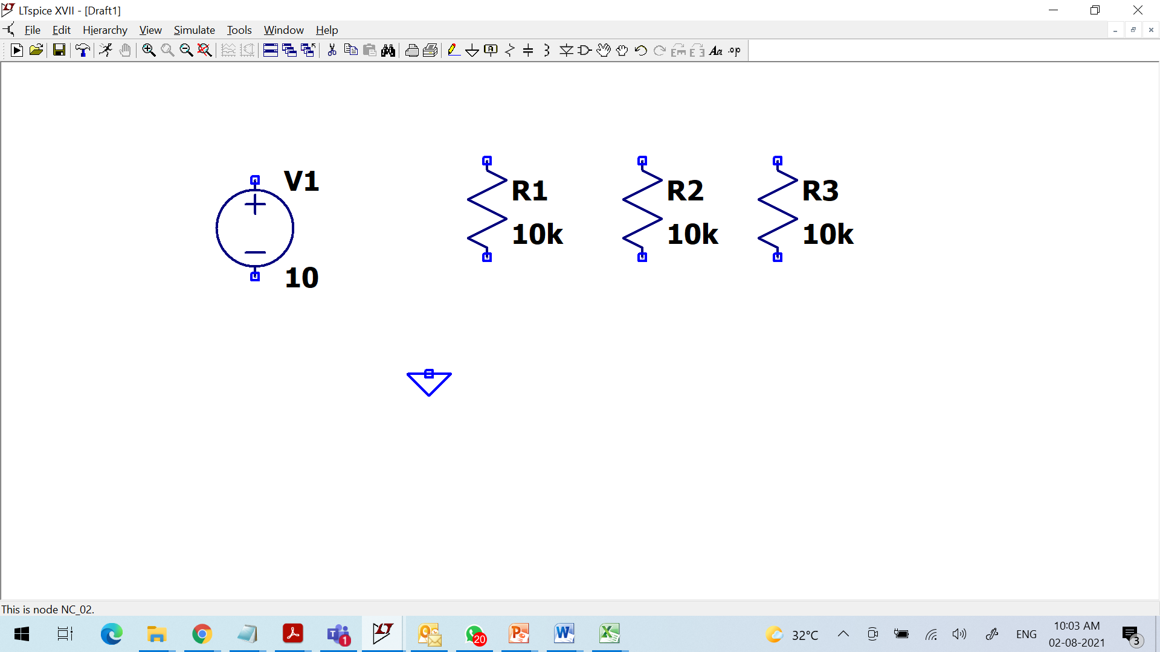
1.12 Introduction to LT Spice
Or

Slide 46
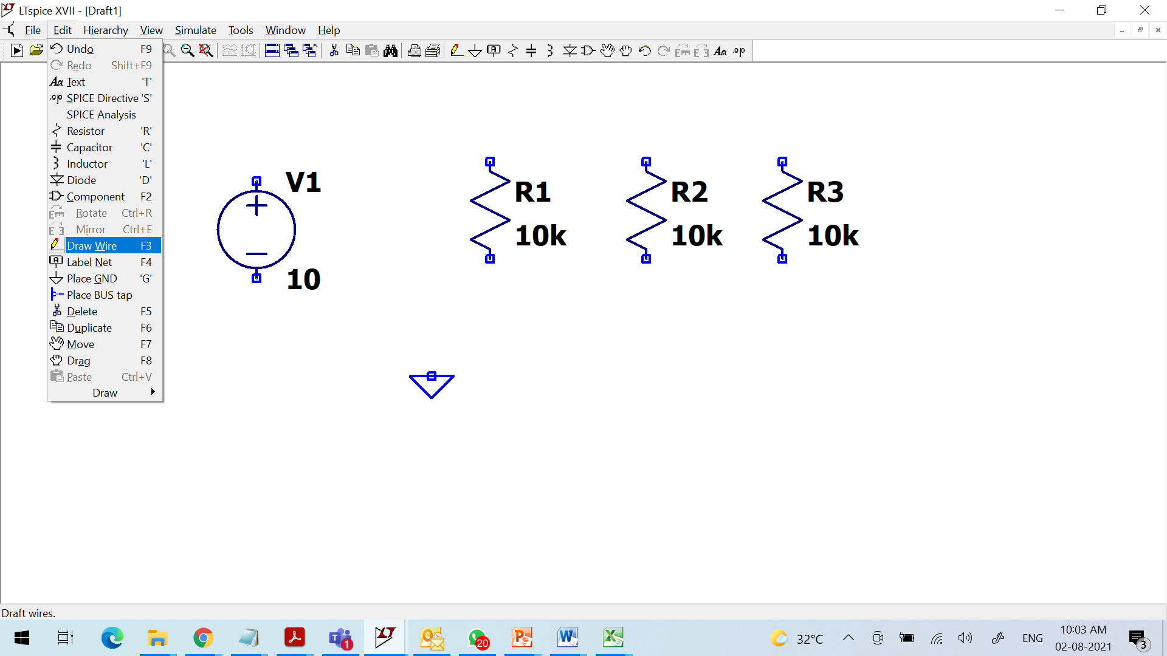
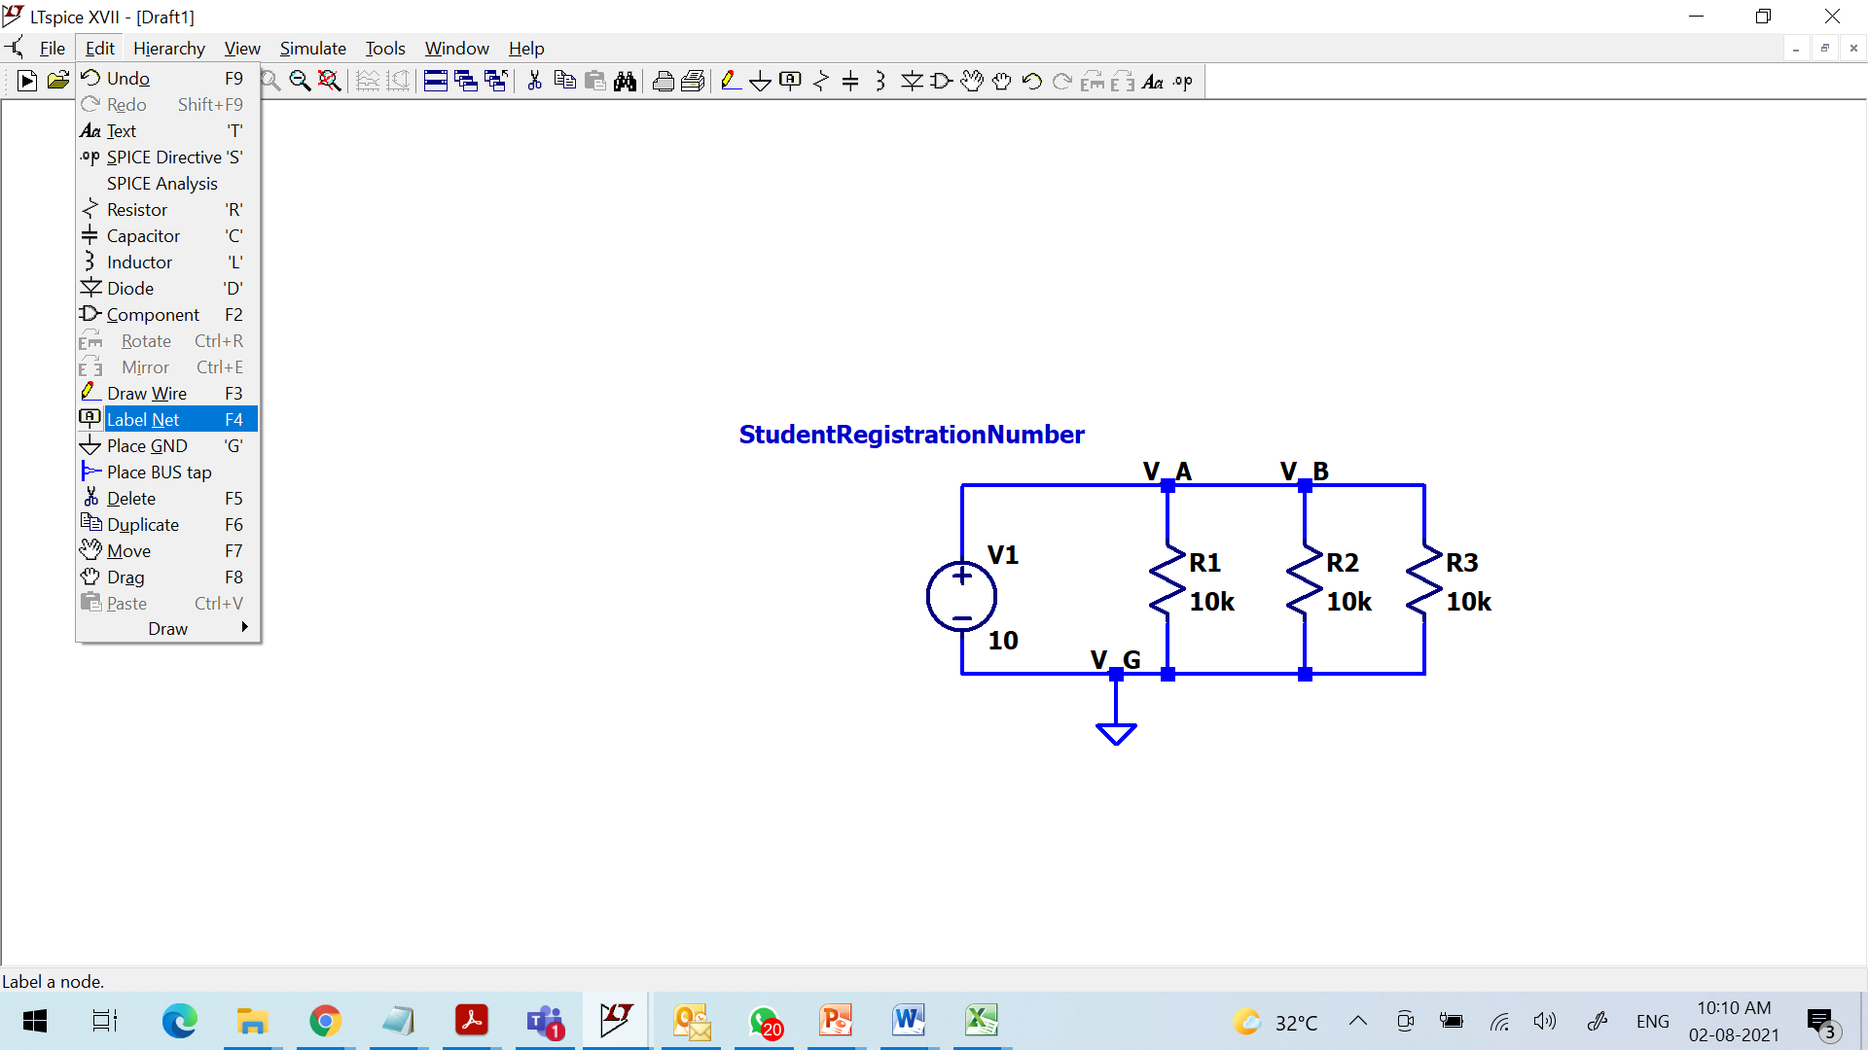
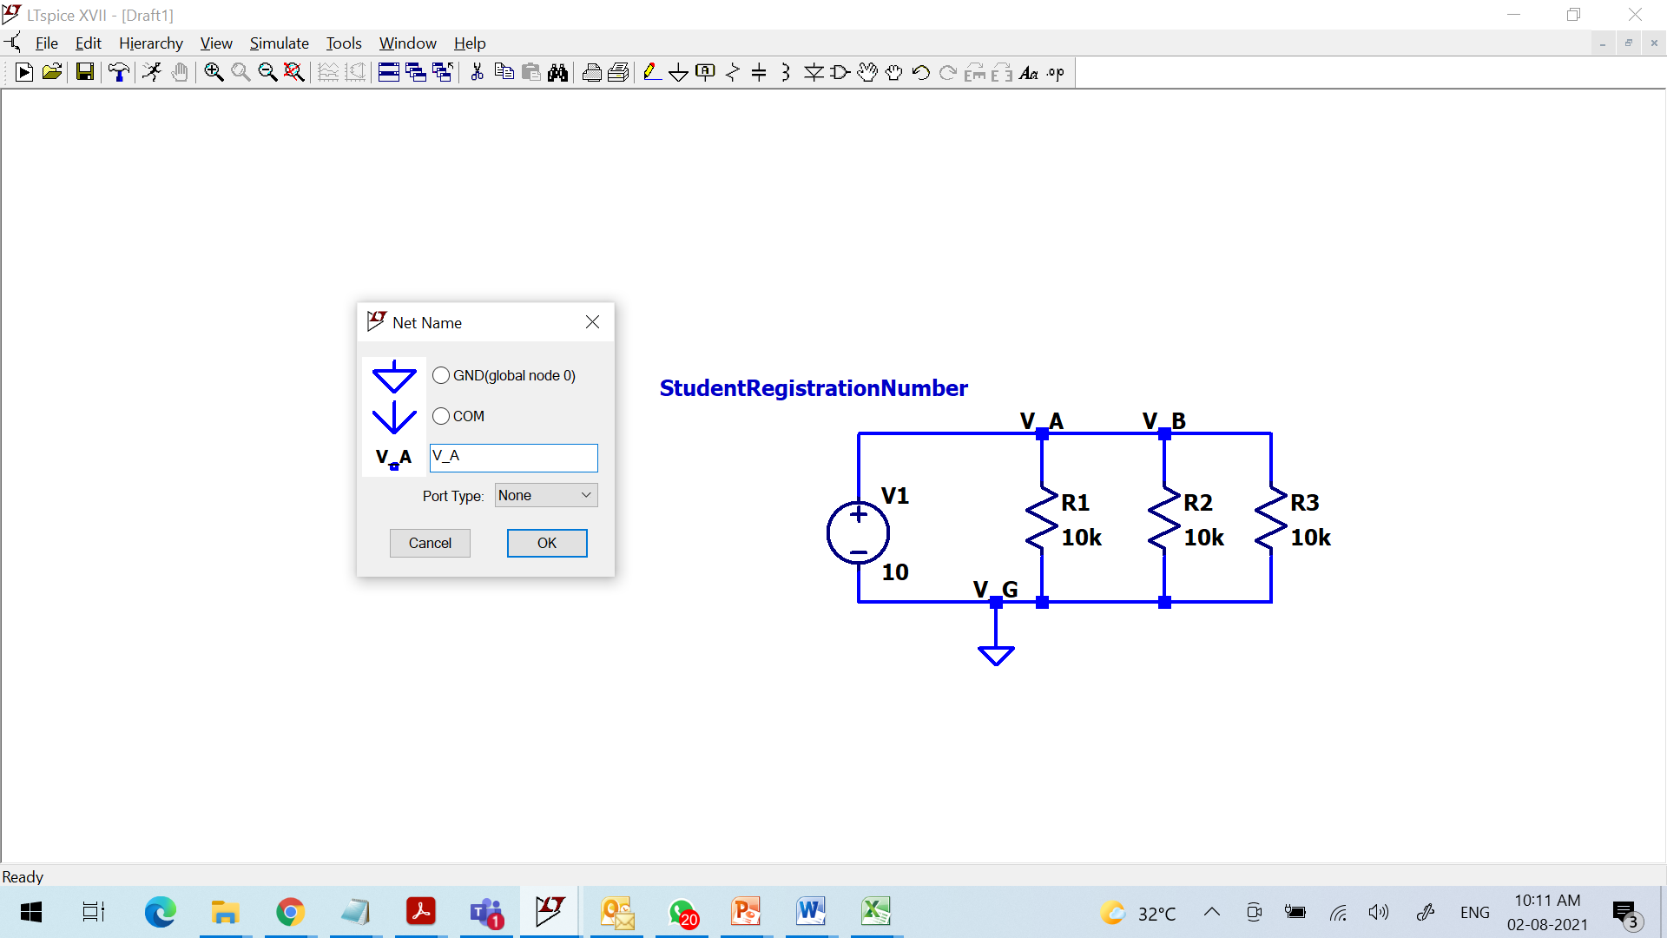
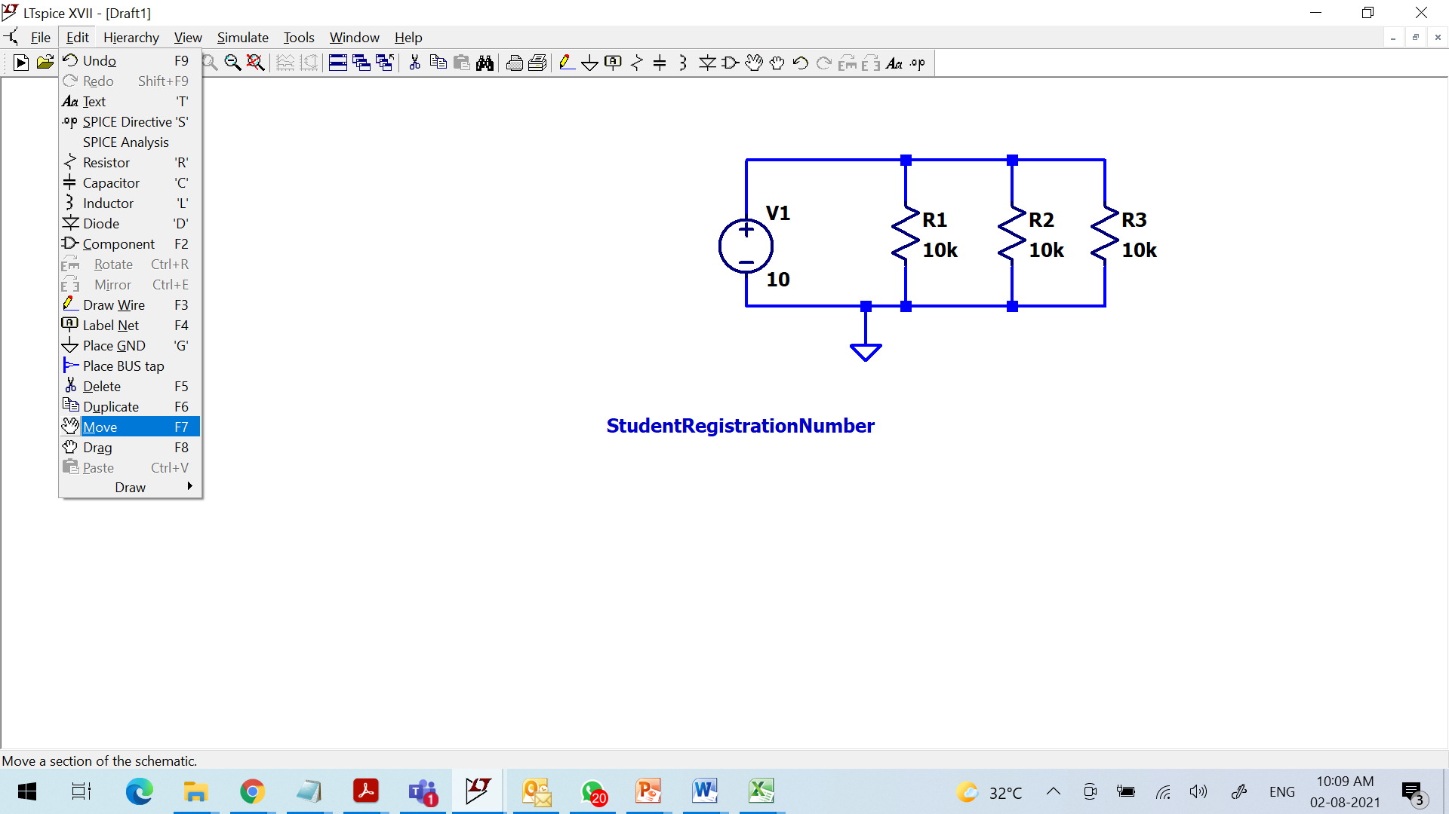
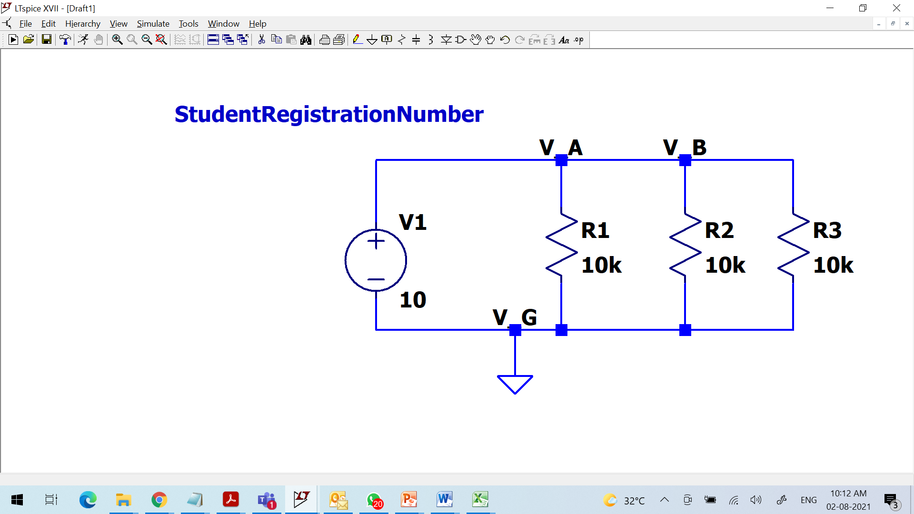
1.12 Introduction to LT Spice
Or

Slide 47
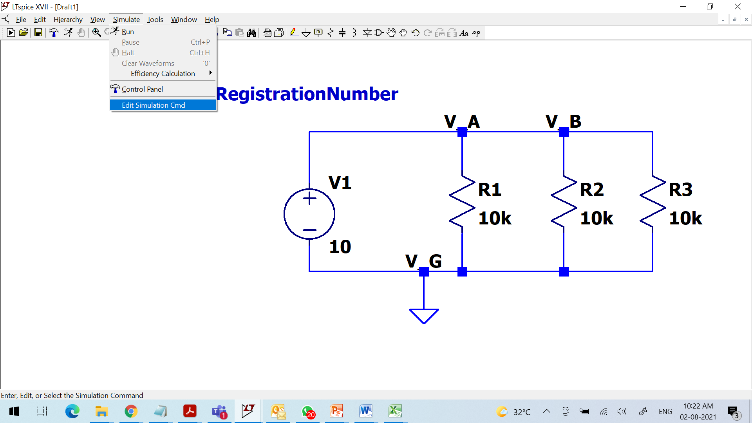
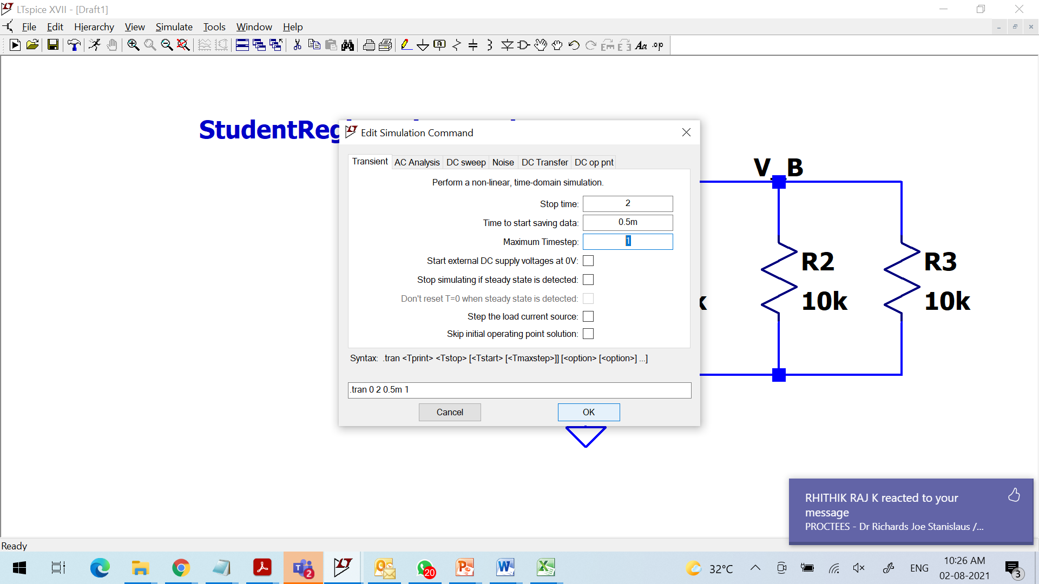
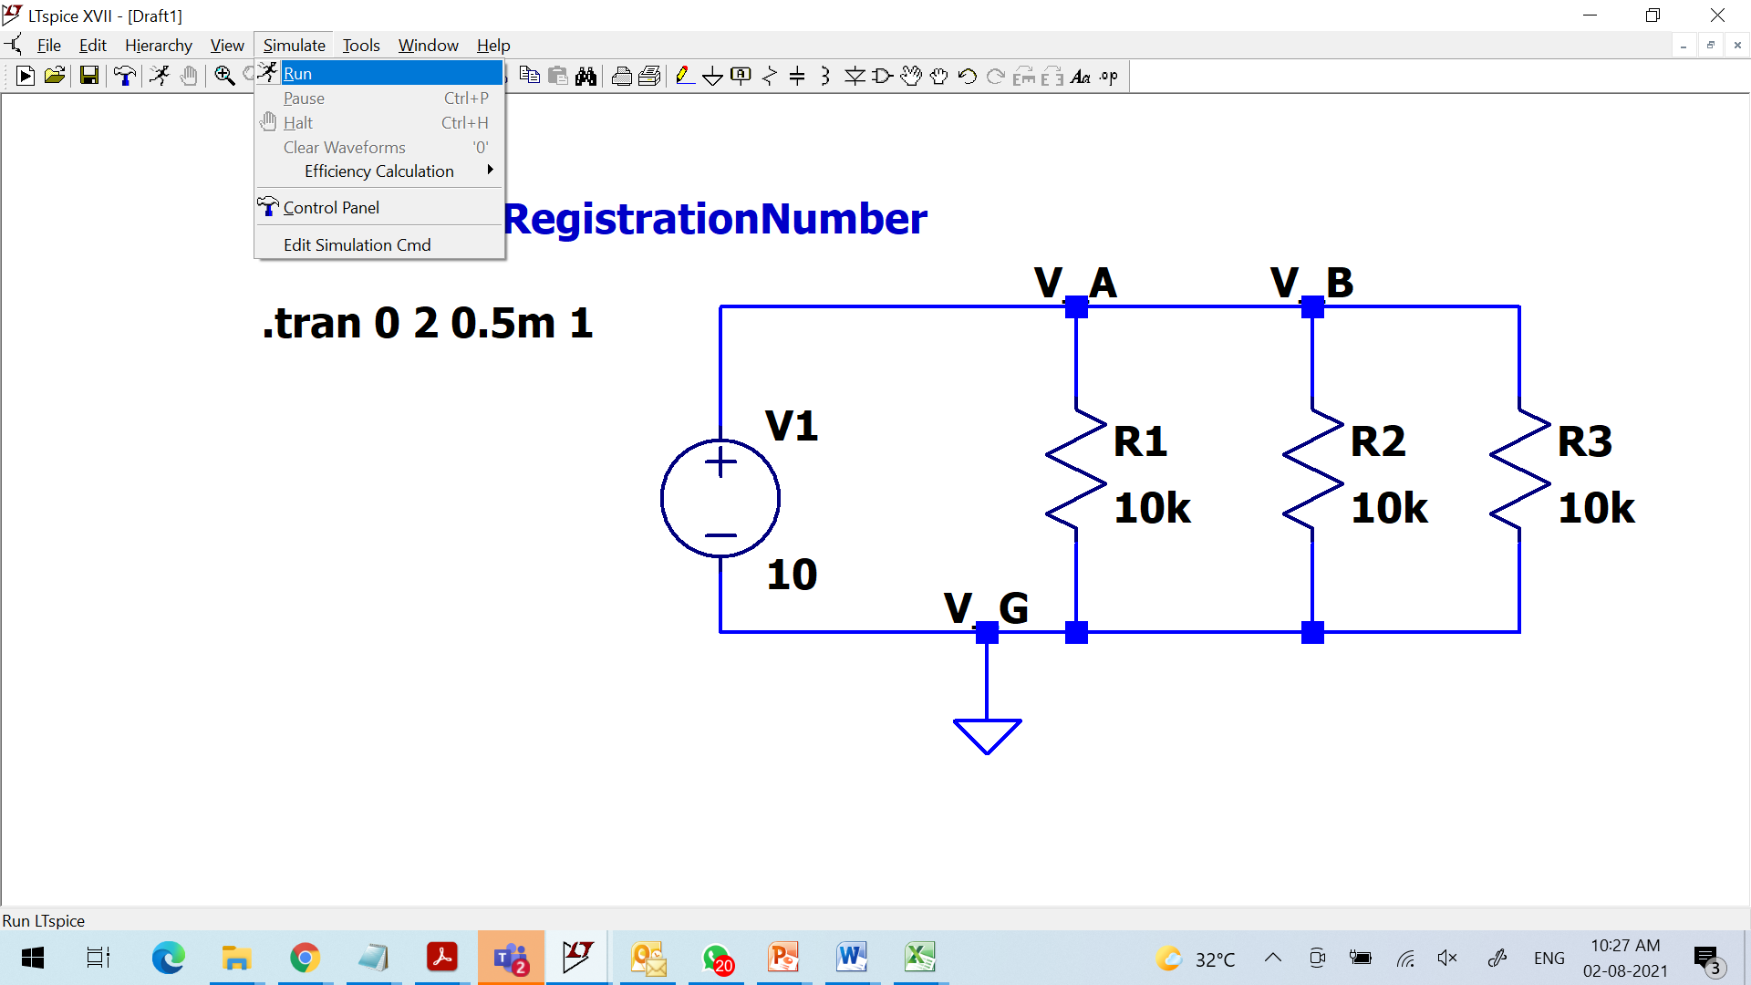
1.12 Introduction to LT Spice

Slide 48
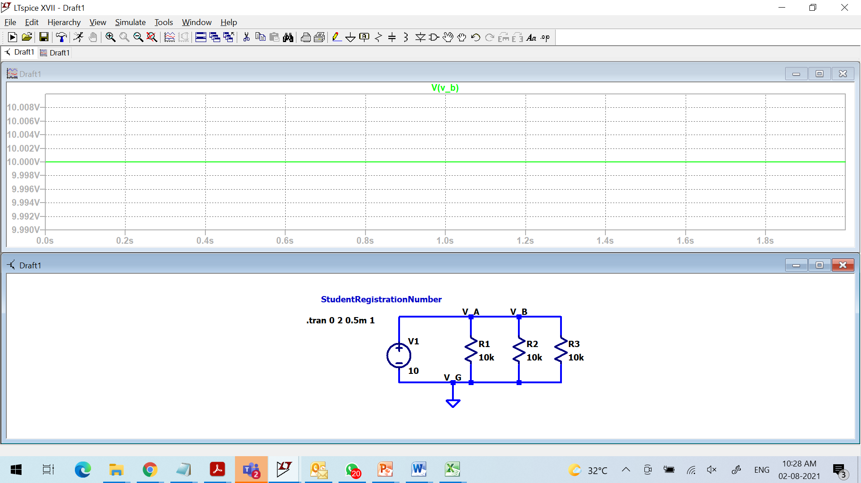
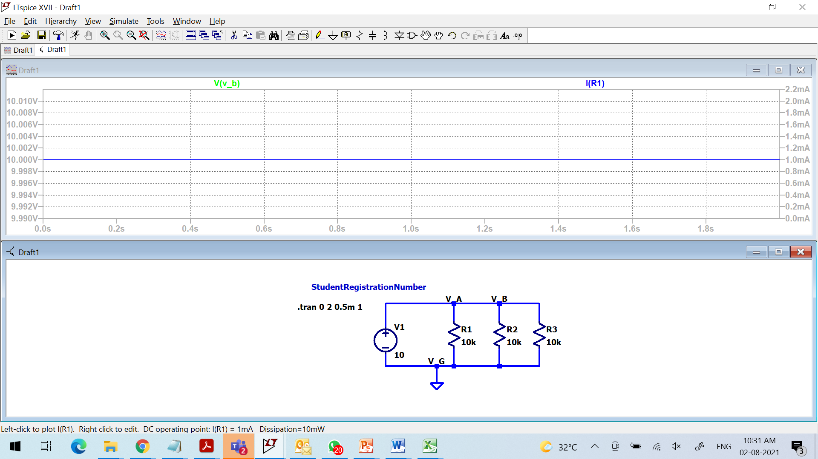
1.12 Introduction to LT Spice: Outputs

Slide 49
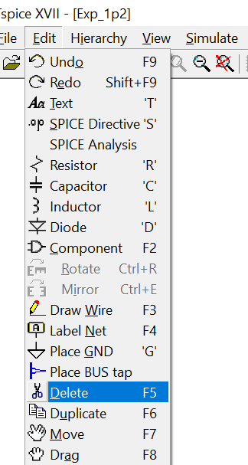
1.12 Introduction to LT Spice

Slide 50
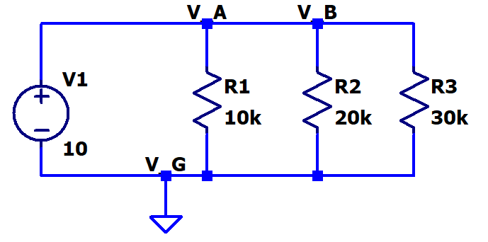
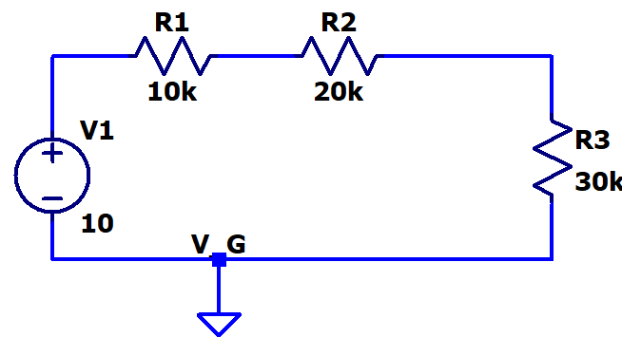
Task 1. To Simulate the circuits and find voltages across resistors and currents through the source and resistances
Circuits

Slide 51
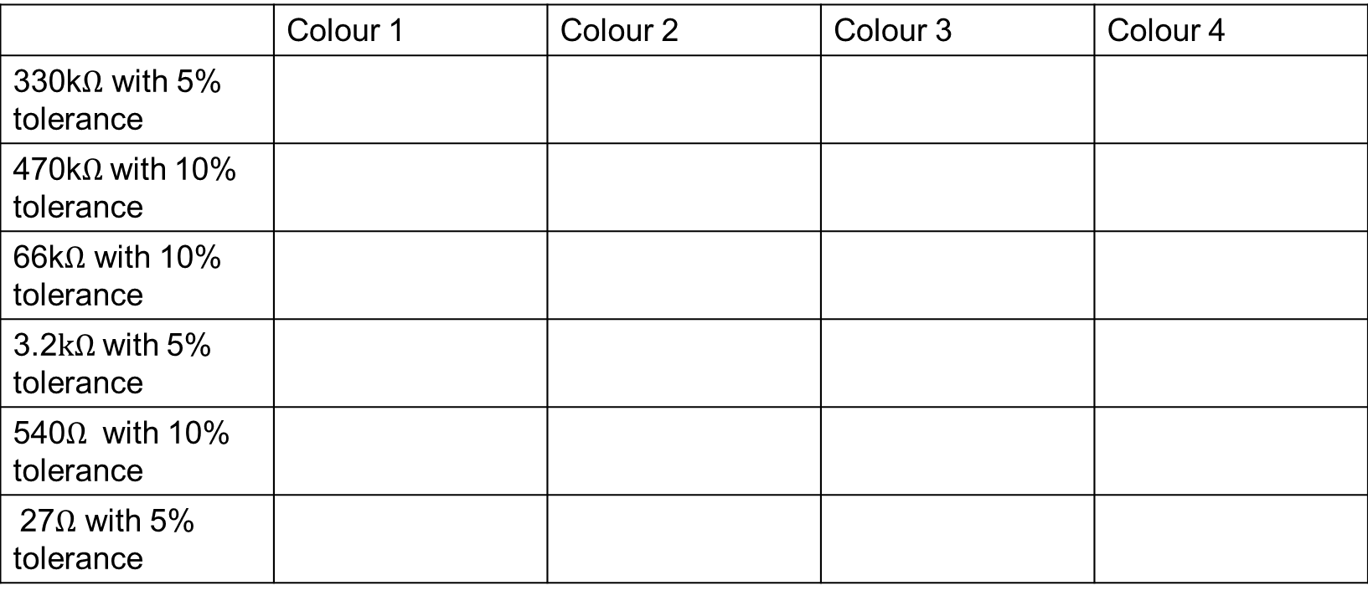
Task 2. To find color code of resistors (4 band system)
 | Colour 1 | Colour 2 | Colour 3 | Colour 4
330k$Ω$ with 5% tolerance
470k$Ω$with 10% tolerance
66k$Ω$ with 10% tolerance
3.2$kΩ$with 5% tolerance
540$Ω$ with 10% tolerance
27$Ω$ with 5% tolerance

Slide 52
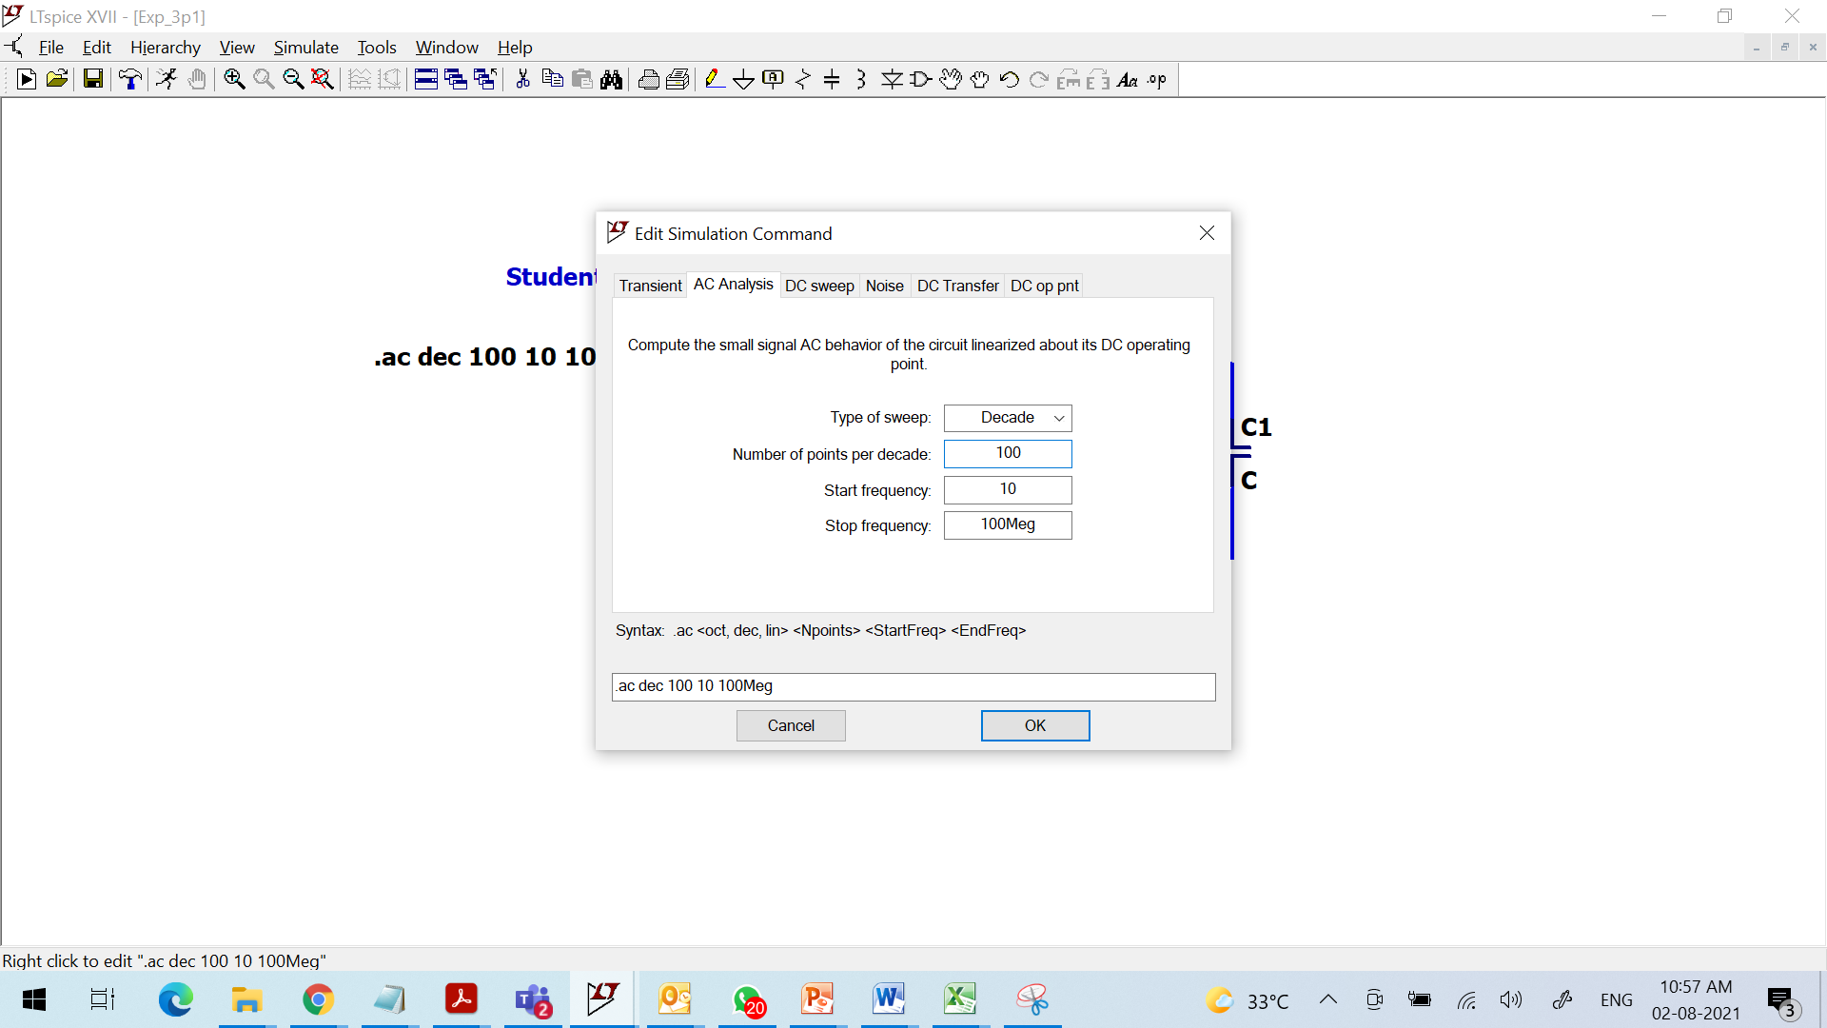
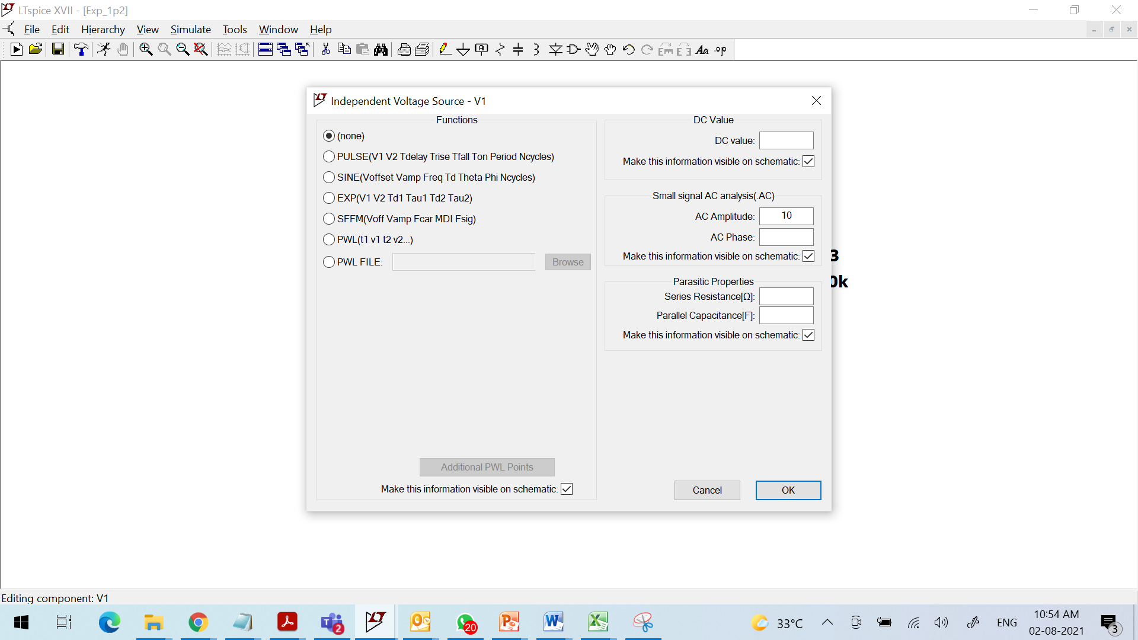
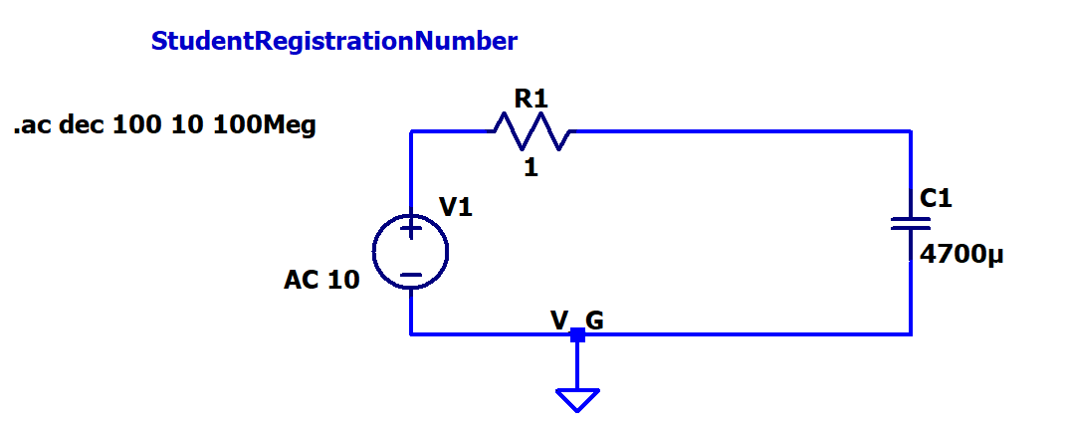
Task 3. To simulate low pass filter (Capacitance)

Slide 53
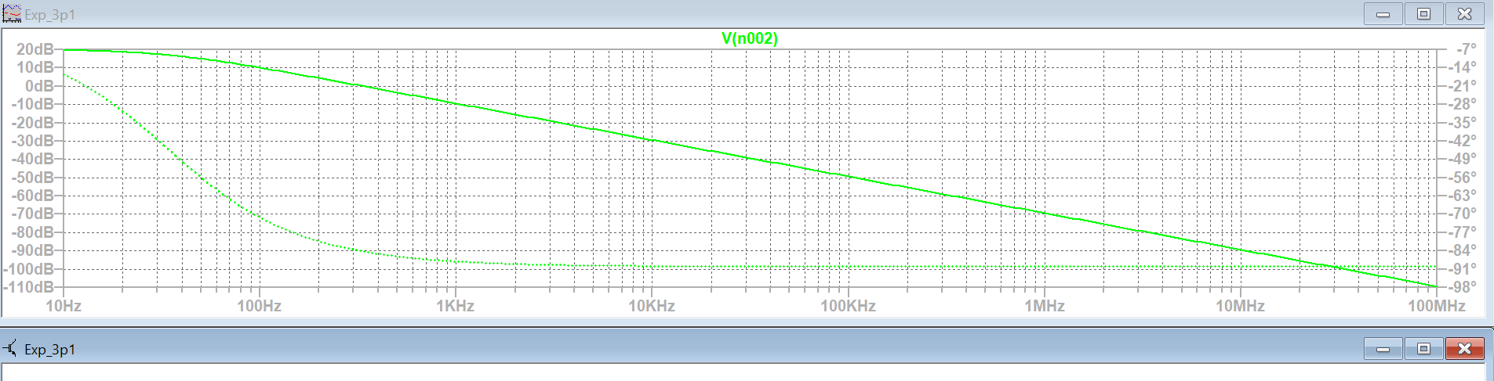
Task 3. To simulate low pass filter (Capacitance)
Output across capacitor

Slide 54
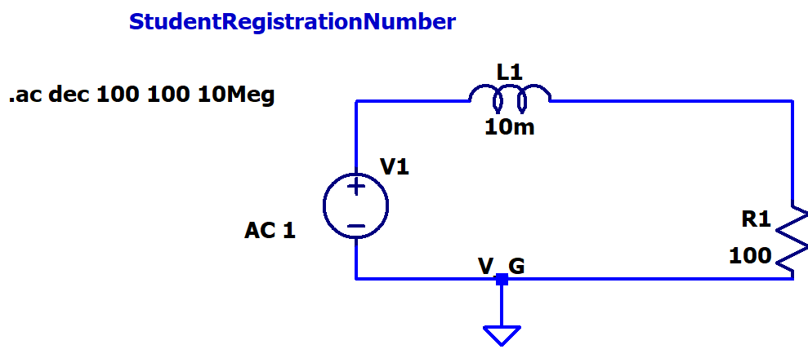
Task 4. To simulate low pass filter (Inductance)

Slide 55

Task 4. To simulate low pass filter (Inductance)
Output across resistor

Slide 56
Task 5: Find total resistance of the circuit seen from the Source (Through formula and with V/I)

Slide 57

Task 6: Find total Capacitance of the circuit

Slide 58

Task 7: Find total Inductance of the circuit

Slide 59
Task 8: Find the capacitance values with codes
Ceramic capacitors:
492
103
352
104
285
681

Slide 60
LAB record instructions:
For the lab experiment,
Write the Aim.
Complete the Software/Hardware components used.
Obtain the expression for the outputs.
Place the respective circuits in LT Spice.
Connect the inputs and outputs. Name them and write the same in the lab copy(inputs and outputs section).
Use probe in LT spice to plot all possible combinations.
Write a concluding statement for each circuit.
Submit the document’s soft copy on time in lms.vit.ac.in when available.

Slide 61
Sources
https://www.electronics-tutorials.ws/resistor
https://www.electronics-tutorials.ws/capacitor/cap_1.html
https://upload.wikimedia.org/wikipedia/commons/b/b9/Capacitors_%287189597135%29.jpg
https://www.meteocercal.info/forum/Thread-capacitor-value
https://en.wikipedia.org/wiki/Inductor
https://www.youtube.com/watch?v=LAUvkiZgq9E
https://www.aplab.com/images/stories/pdfs/VC97%20-%20Auto%20Range%20Digital%20Multimeter.pdf

